Slide 1
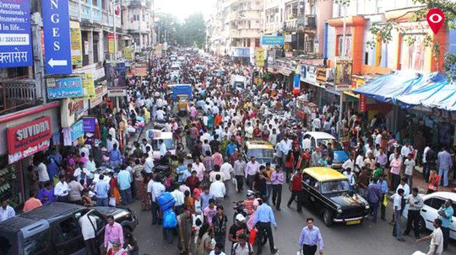
Population

Slide 2
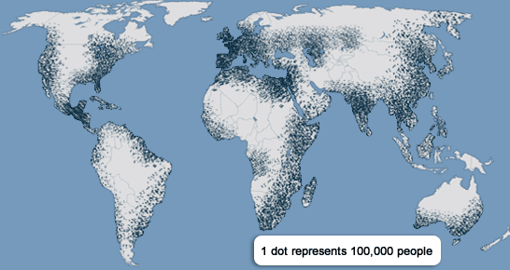
How is the World’s population distributed?

Slide 3
DEMOGRAPHY
Study of population trends
Demographics
Statistical Characteristics of a Population.
Explain the demographics of Great Neck South High School

Slide 4
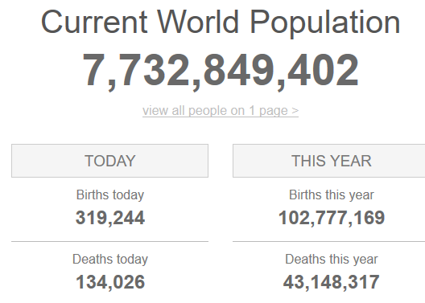
https://www.worldometers.info/world-population/

Slide 5
Main Area of Population Density

Slide 6
Five Main Areas of Population Density
East Asia
South Asia
Southeast Asia
Western and Central Europe
Northeastern United States and Canada

Slide 7
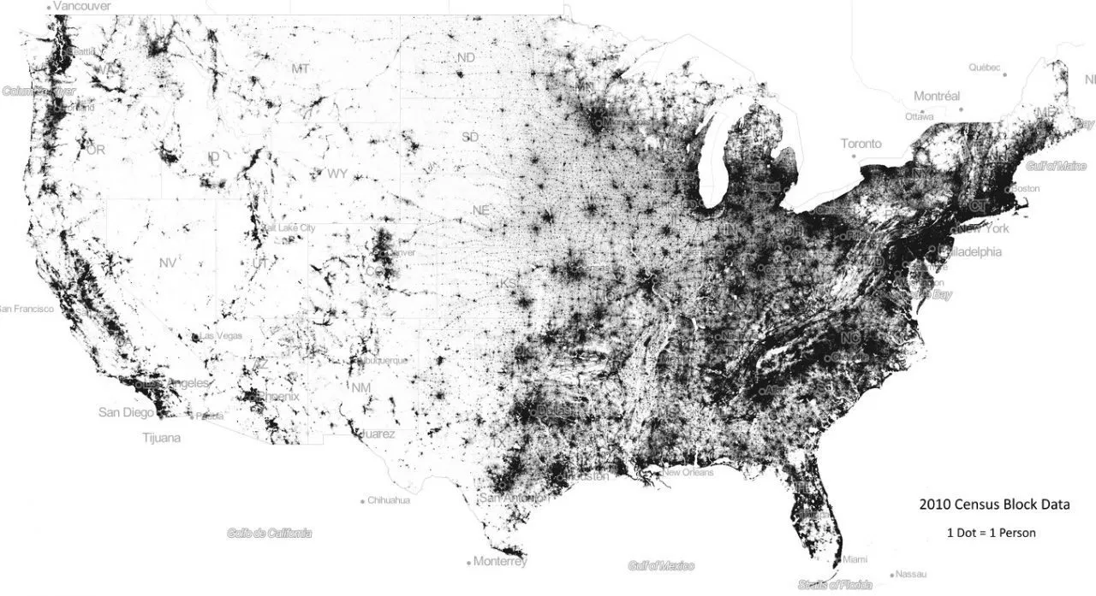

Slide 8
Population Density
Arithmetic Density
Divides the entire population by the total land area
Physiologic Density
Only takes into account the land that is being used by humans.

Slide 9
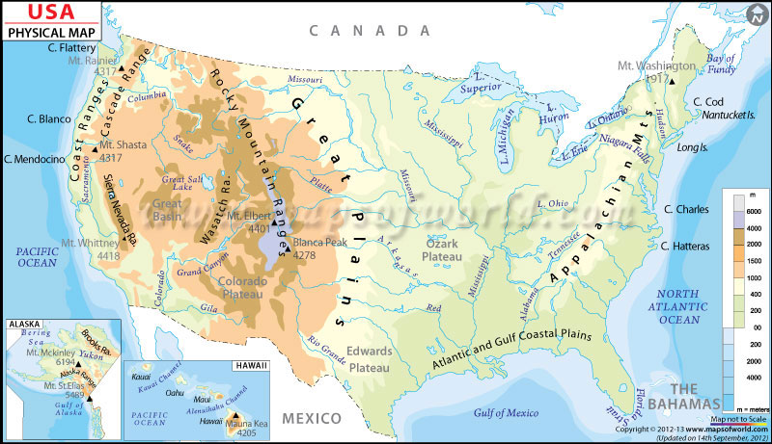

Slide 10
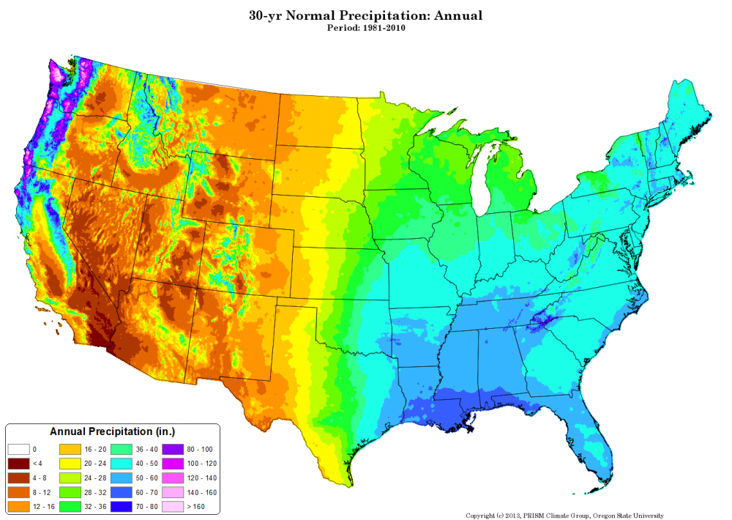

Slide 11
Why do people live where they do?
Ecumene
Habitable land.
Includes land with adequate water sources, relatively flat terrain, and available human food sources.
Carrying Capacity
The ability of the land to sustain a certain number of people.

Slide 12
Overpopulation -
when the needs of a population cannot be met by the available resources.
In other words, when the carrying capacity is exceeded.

Slide 13
