Slide 1
What can we learn from maps?

Slide 2
MAPS
Do Now:
Spend 3 minutes drawing a map of something – It can be your route to school, your class schedule, the places you have lived, or anything else. Include features that you believe will help the viewer best understand what the purpose of your map is.

Slide 3
What is a Map?
Based on what you have done, how would you define “map.”
Definition – diagram of an area that shows physical and/or human features.

Slide 4
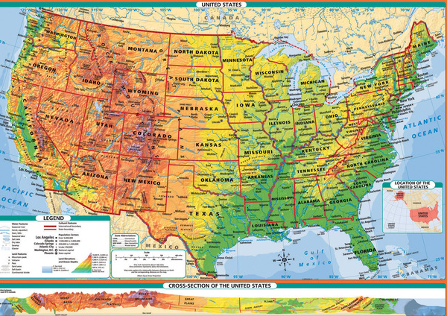
General Reference Map

Slide 5
Thematic Map
emphasizes a specific subject area or theme connected to a specific geographical area.

Slide 6
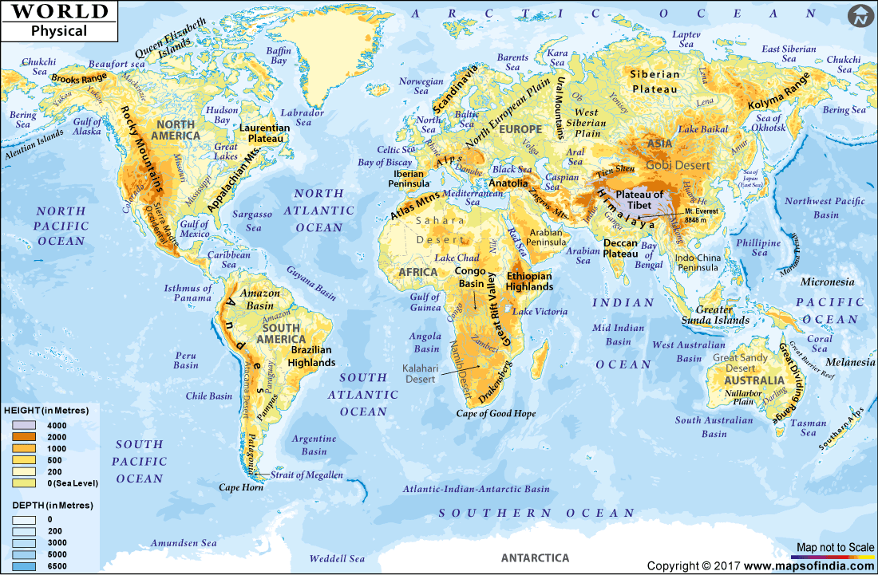
Physical Map

Slide 7
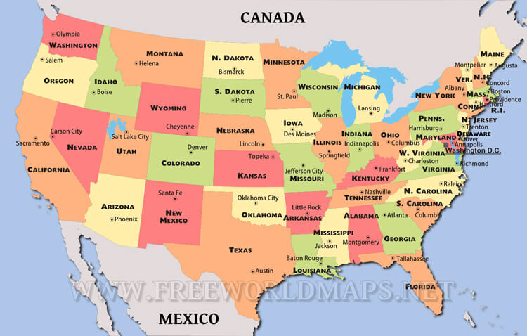
Political Map

Slide 8
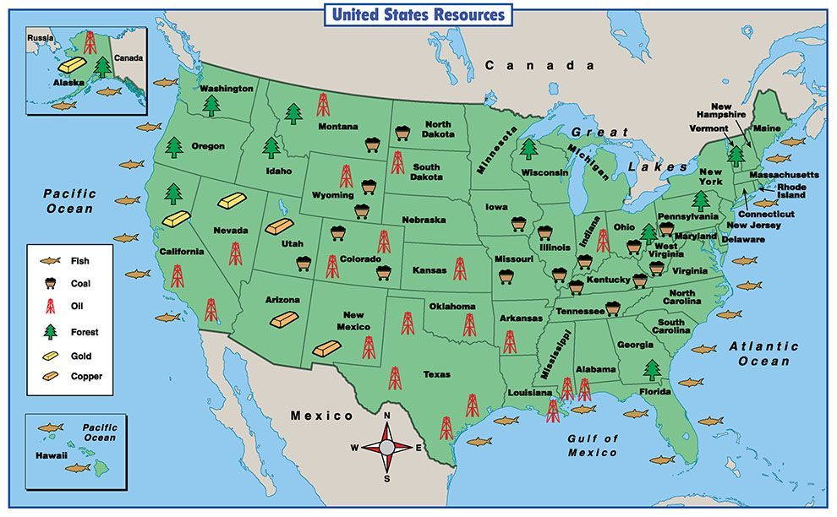
Resource Map

Slide 9
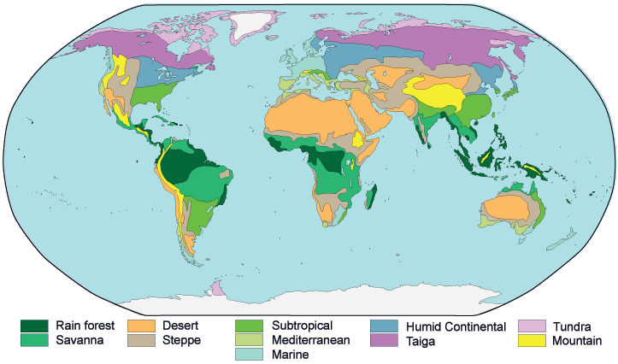
Climate Map

Slide 10
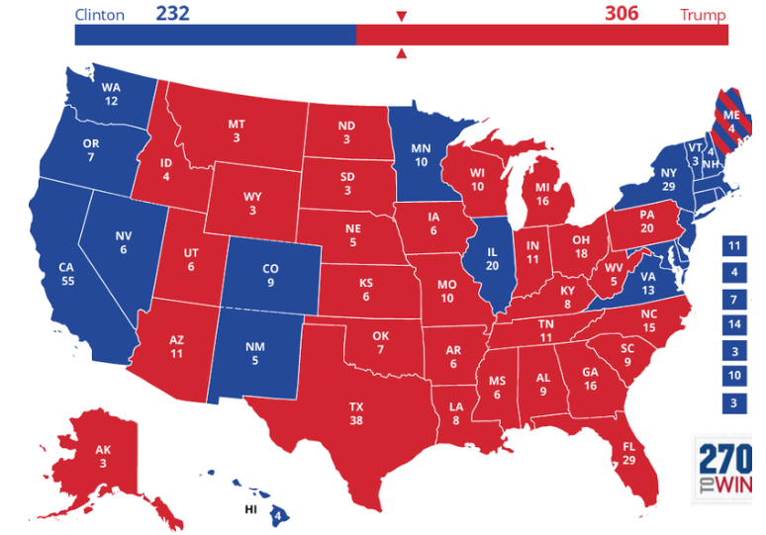

Slide 11
Choropleth Map
a thematic map in which areas are shaded or patterned in proportion to the measurement of the statistical variable being displayed on the map

Slide 12
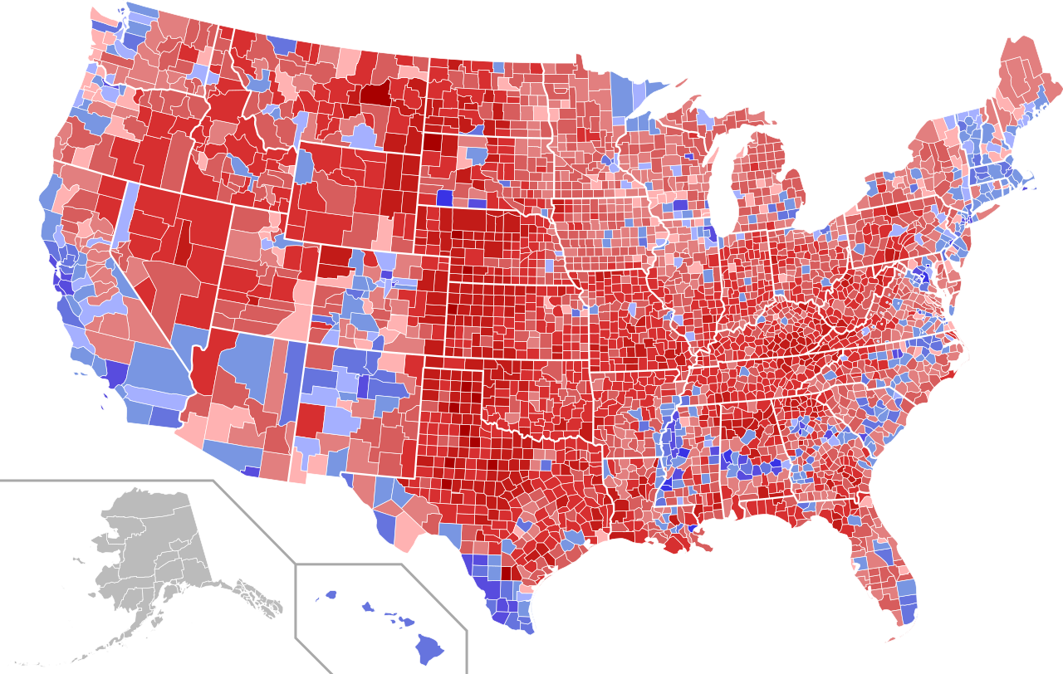
Electoral Outcomes in 2016 Presidential Election by County

Slide 13
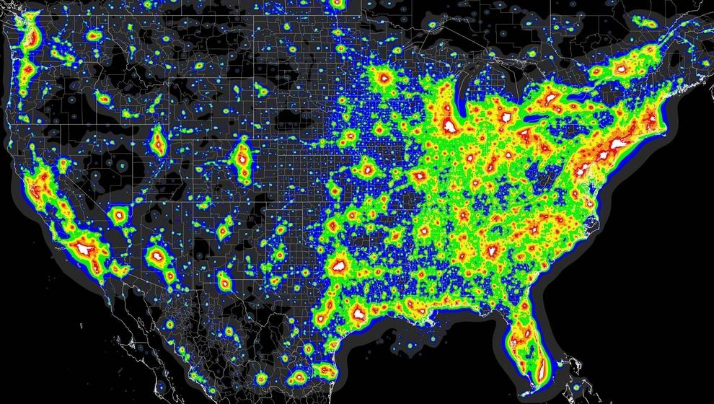
The US Population by Light Intensity

Slide 14
Family income of $421,926 or higher is top 1% nationally

Slide 15
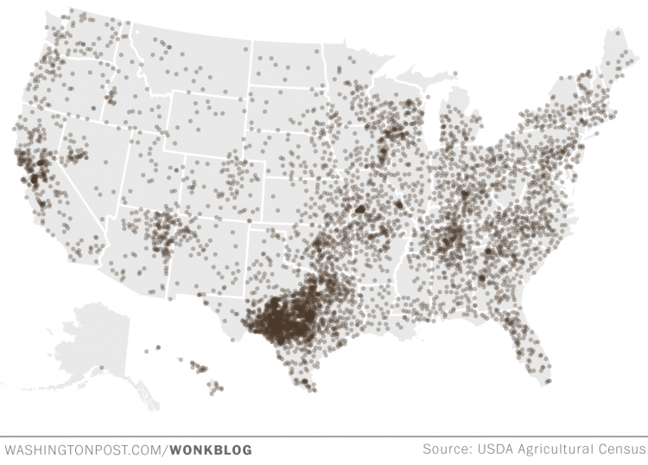
Dot Distribution Map

Slide 16
Dot Distribution (Density) Map
a map type that uses a dot symbol to show the presence of a feature or a phenomenon
Helps understand Density

Slide 17
One dot = 500 goats

Slide 18
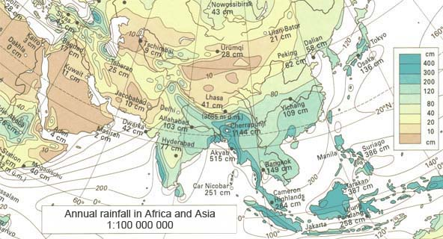
ISOLINE MAPS
The isoline representation is the most used method to visualize variations in quantitative phenomena over a particular area. Commonly used to show temperature, precipitation,or ground elevations.

Slide 19
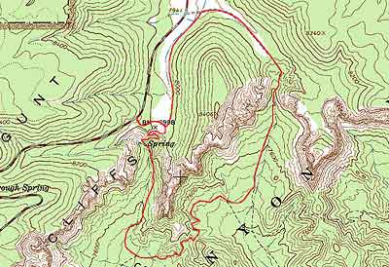

Slide 20
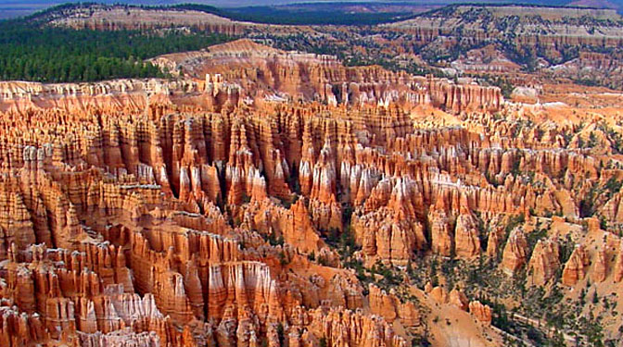

Slide 21
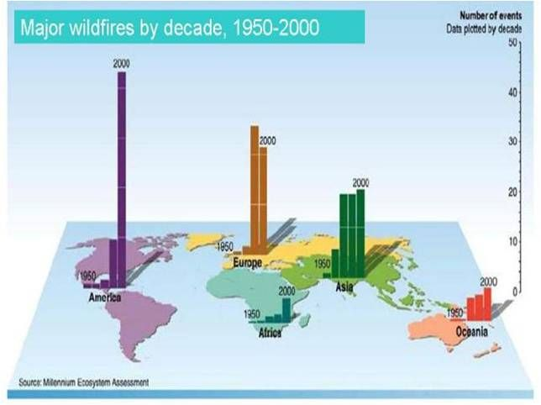
Located Charts

Slide 22
Located Chart
Bar graph, pie graph or other visual representation of data appears on map to make comparisons between places.

Slide 23
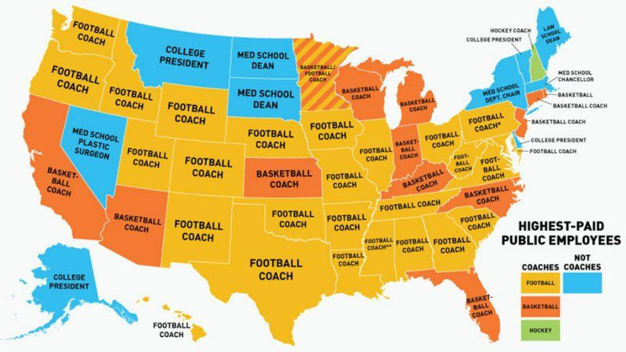
Highest Paid Public Employee

Slide 24
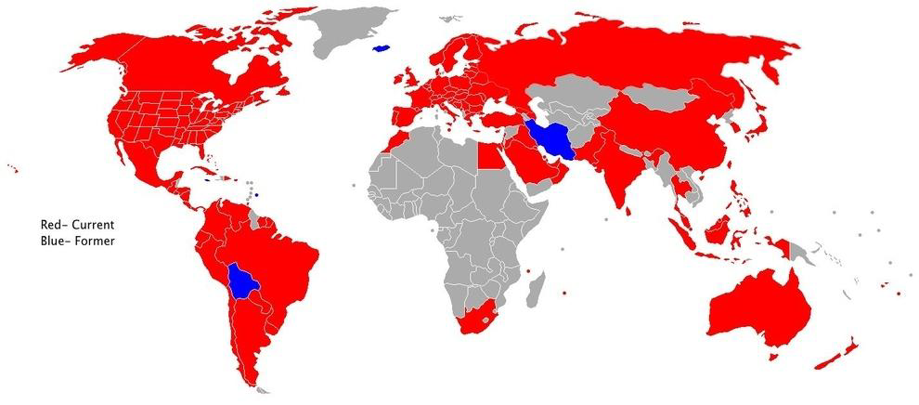
Countries with a McDonalds

Slide 25
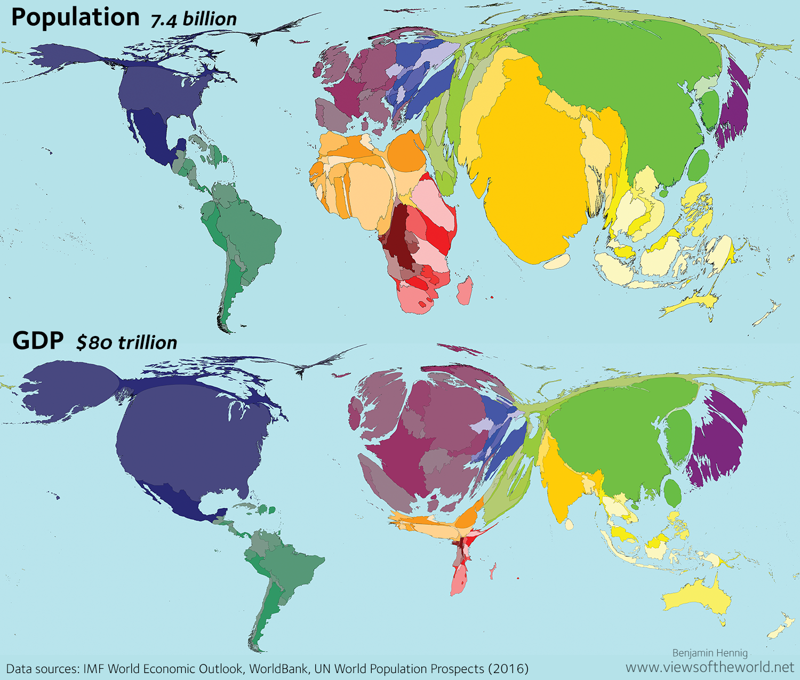
Cartogram

Slide 27
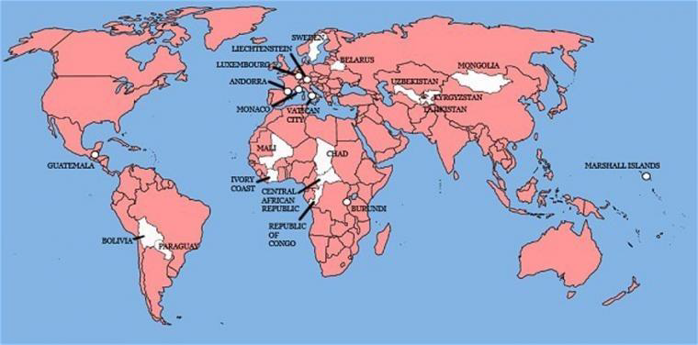
Where England has invaded

Slide 28
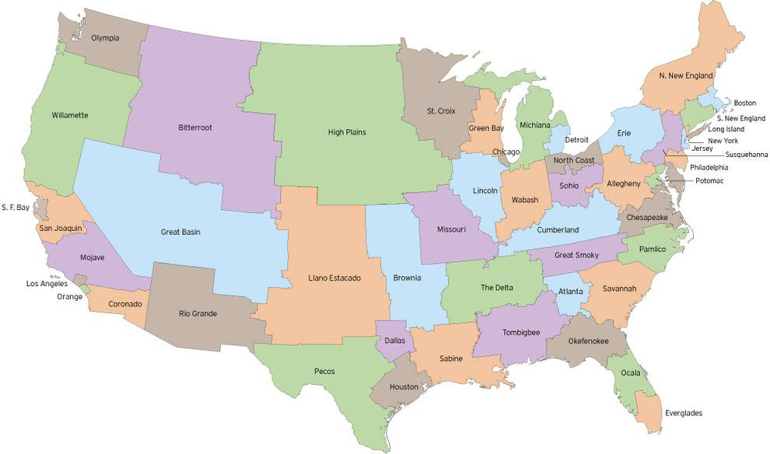
The US if Population Were Evenly Distributed

Slide 29
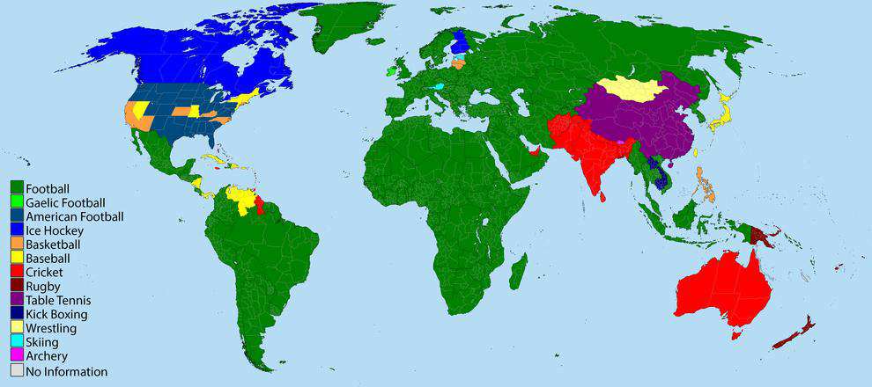
Most Popular Sport Played

Slide 30
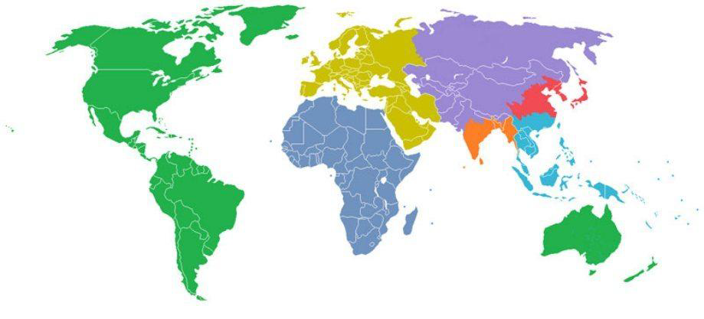
Continents With Even Population Distribution

Slide 31
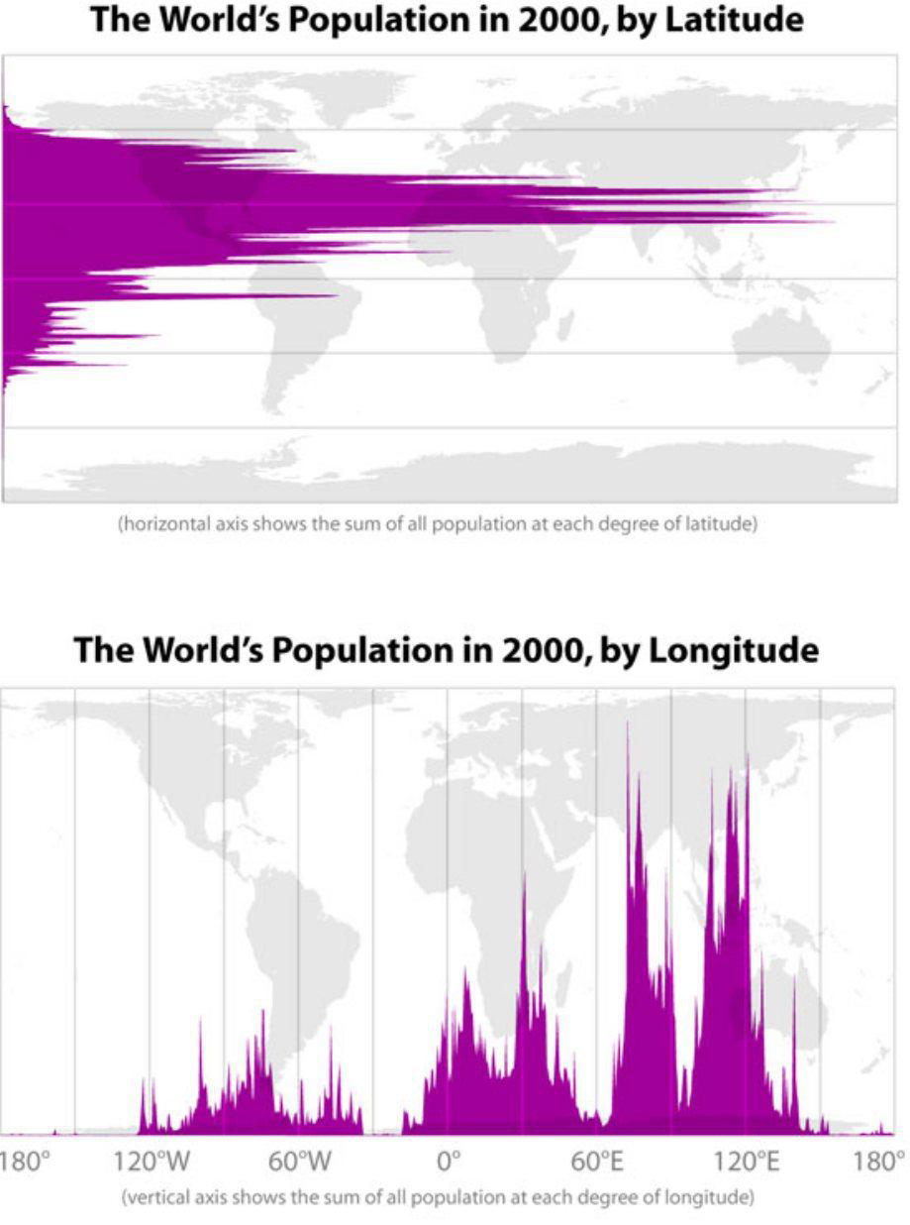

Slide 32
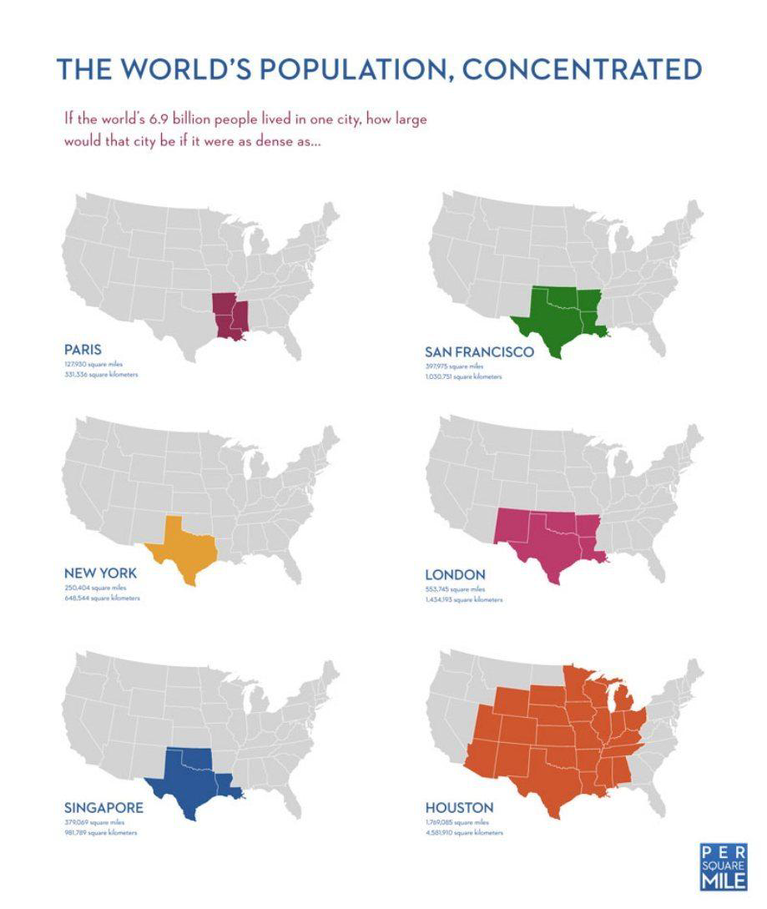

Slide 33
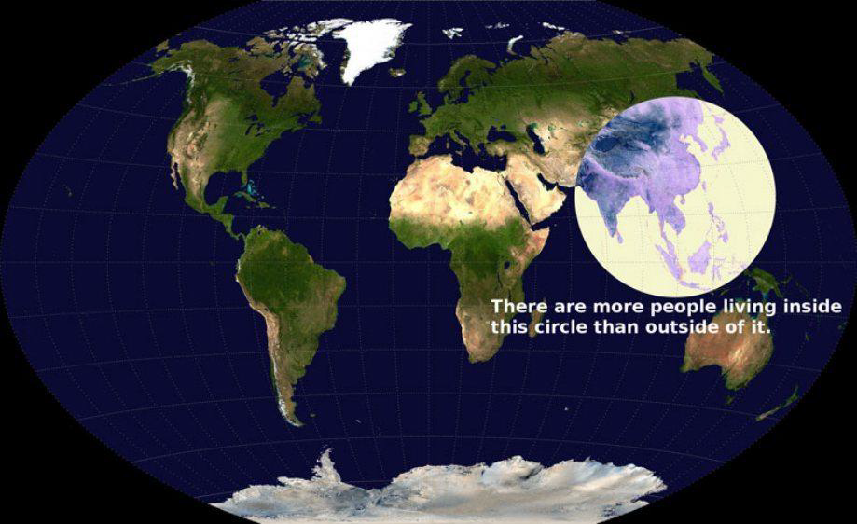

Slide 35
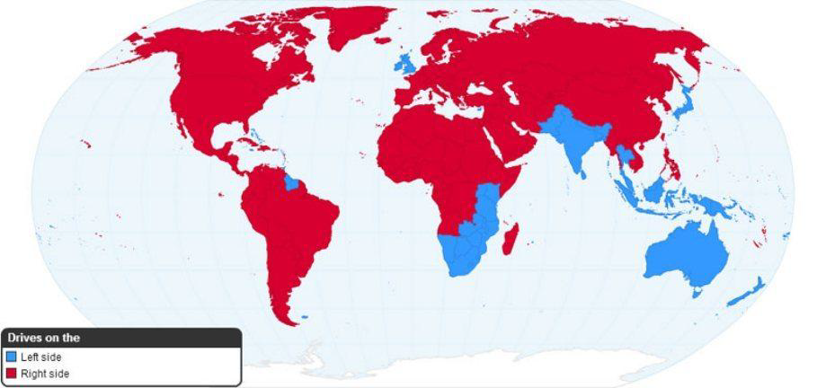
Driving on the right side or left side

