Slide 1
Five Themes of Geography

Slide 2
Do Now: What comes to mind when you hear the word “geography?”

Slide 3
AIM – How does the expression the “why of where” help us understand human geography?

Slide 4
Physical Geography
Human Geography

Slide 5
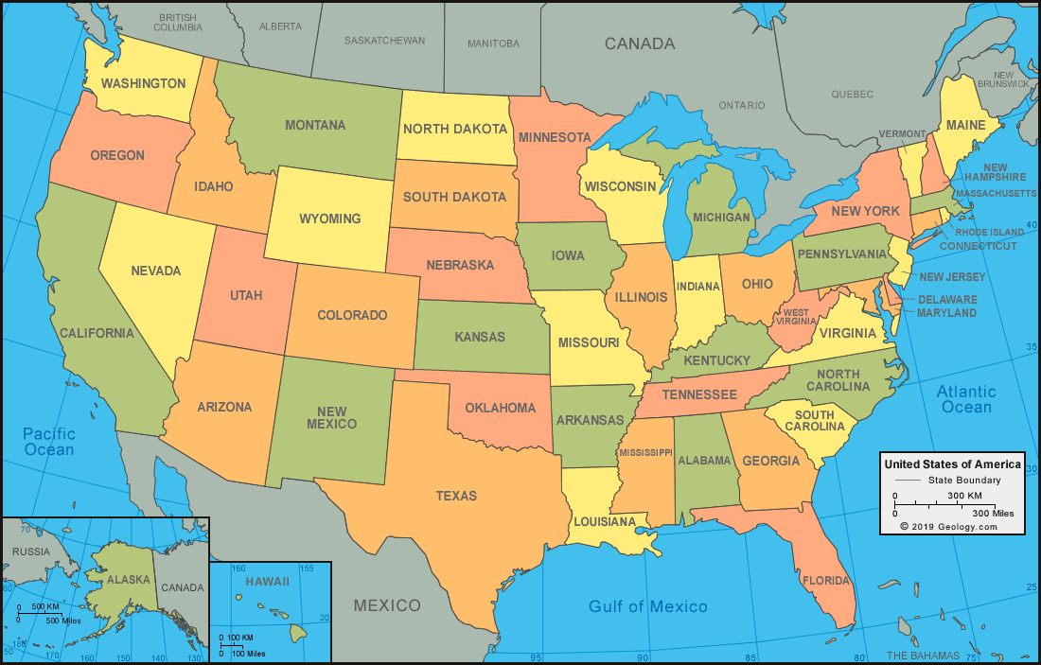
Human or Physical Features?

Slide 6
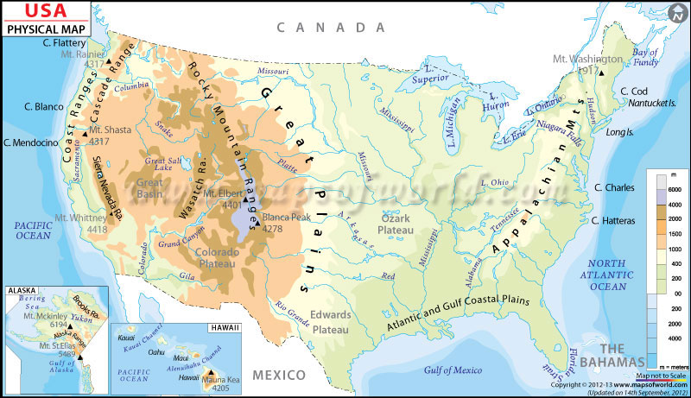

Slide 7
Five Themes
Place
Location
Region
Movement
Human-Environment Interaction

Slide 8
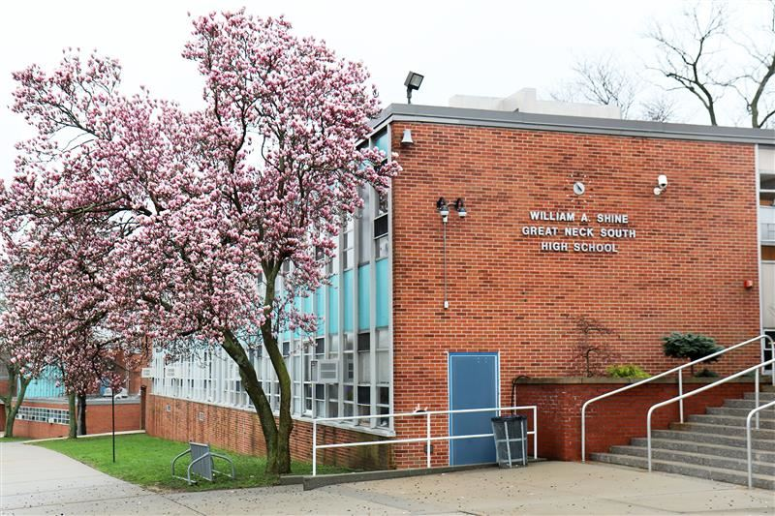
Place
Describe Great Neck South High School
Physical Characteristics
Human/Cultural Characteristics

Slide 9
Place
Physical characteristics and the characteristics of the people who live there
Physical Characteristics
Landforms/topography
Climate
Plants and minerals
Human Characteristics
Race/ethnicity
Buildings/man made structures
Economy
Government
religion

Slide 10
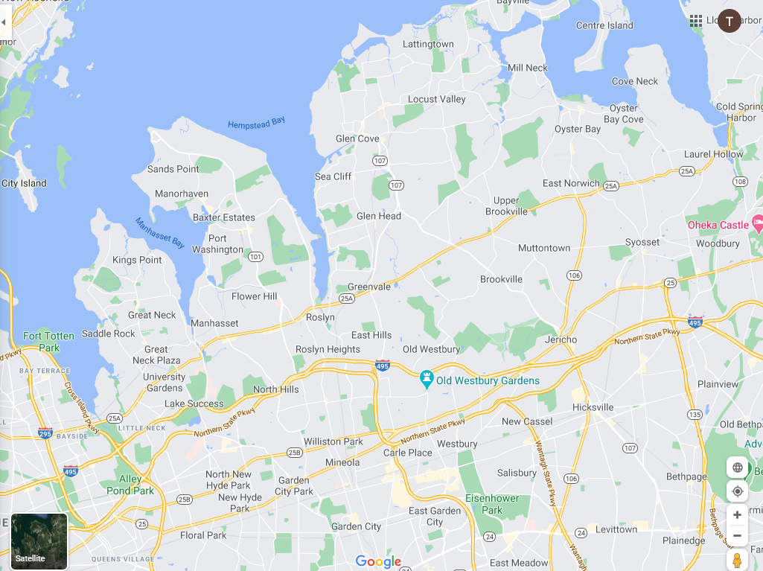
Toponyms – What’s in a name?

Slide 11
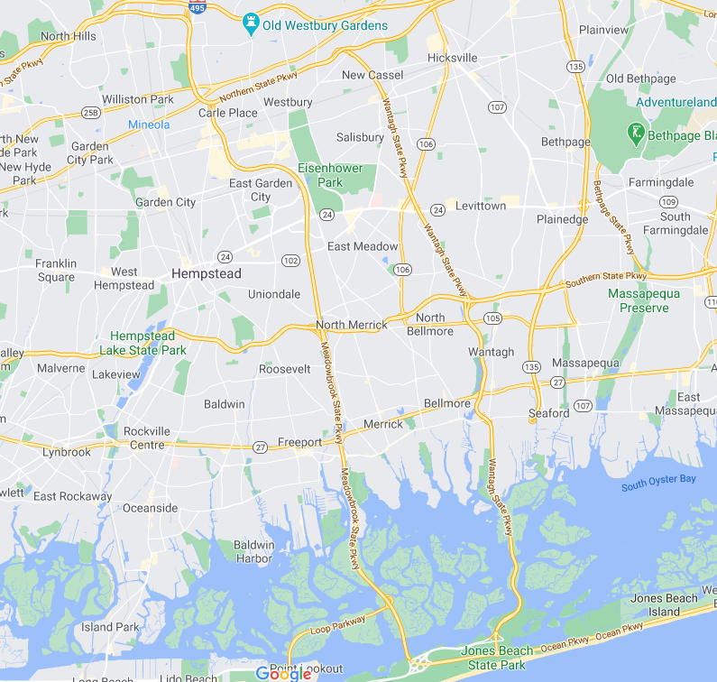

Slide 12
What’s in a name?
New York?
Oyster Bay?
Levittown?
Lake Success?
Great Neck?
New Orleans?
Cincinnati?
Harlem?
The Oranges (New Jersey)

Slide 13
Toponyms
-Reveal
-History
-Ethnic or national Origins
-Values
-Physical geography

Slide 14
Site and Situation
Site
Exact location of a place
For example – longitude and latitude
Natural Physical characteristics (hilly, plain, island, etc.)
Situation
Where a place is relative to its surrounding environment
Relative to natural features (for example – nearness to an ocean or river
Relative to other human features
Other cities, transportation routes
Some places can have a desirable situation but not a desirable site or vice versa.

Slide 15
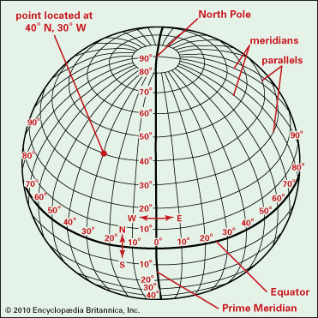
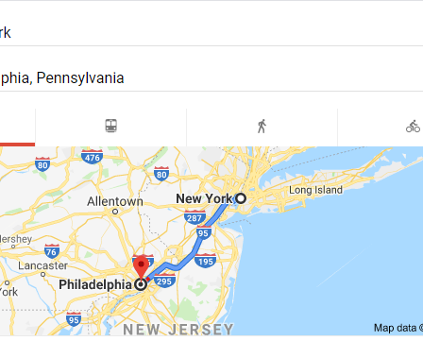
Location
ABSOLUTE
RELATIVE

Slide 16
Other types of absolute location?
11020
341 Lakeville Road

Slide 17
The Cultural Landscape
Definition – the human and physical characteristics of a place and how they interact with each other.

Slide 18
Region
How is a region different from a place?
Definition
An area with places that share similar characteristics (human/cultural or physical) or processes.

Slide 19
Identify three regions of the U.S. What makes them distinctive regions?

Slide 20
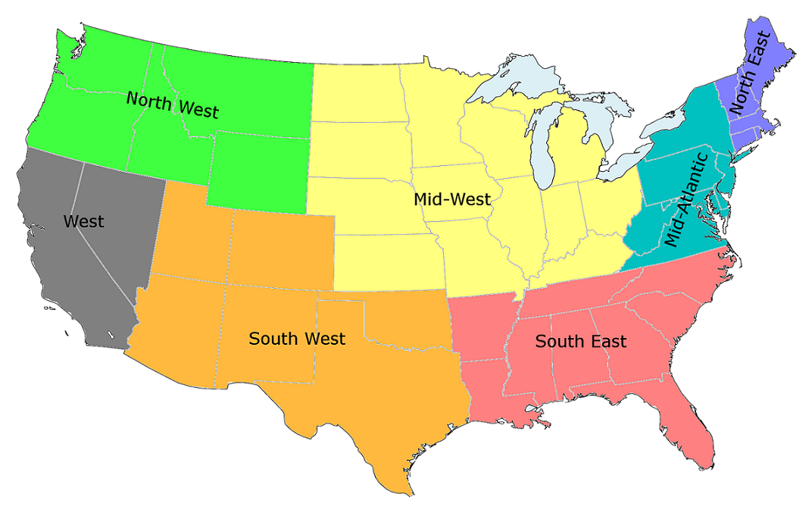
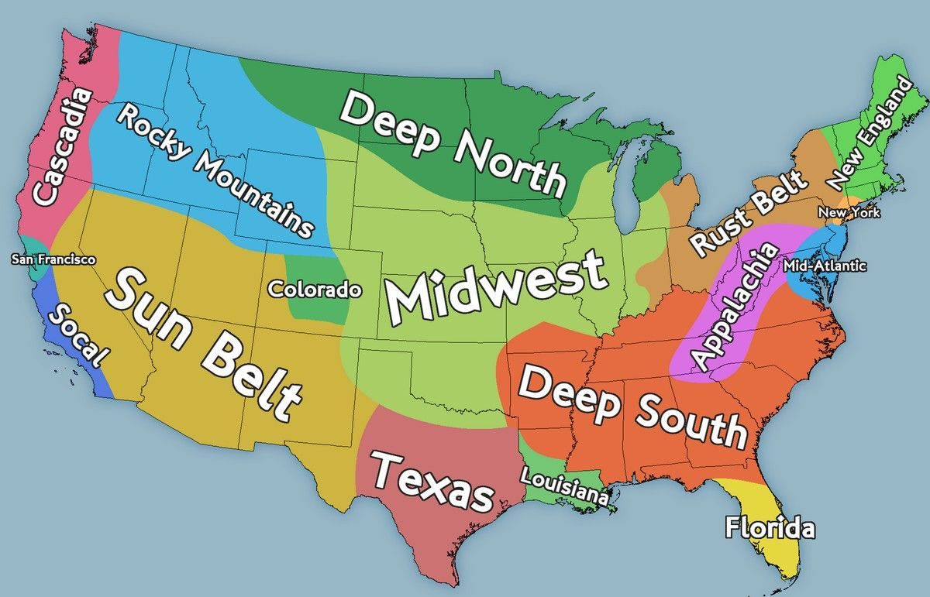
Regions of the United States

Slide 21
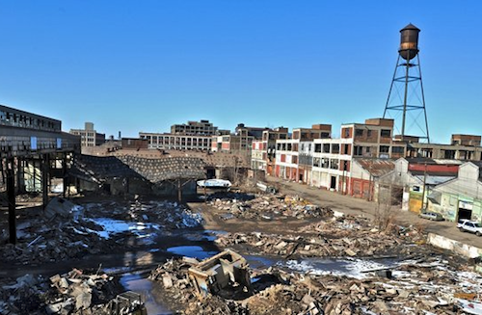
The Rustbelt

Slide 22
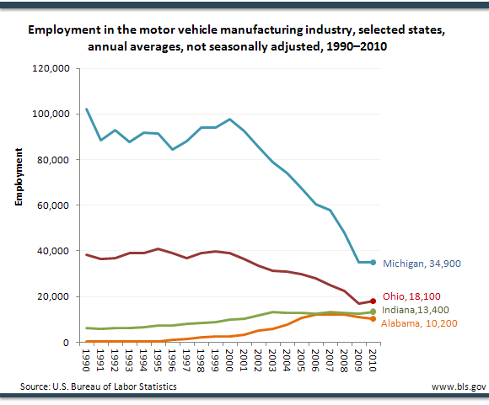

Slide 23
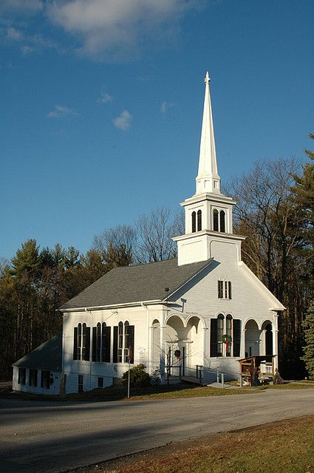
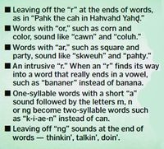
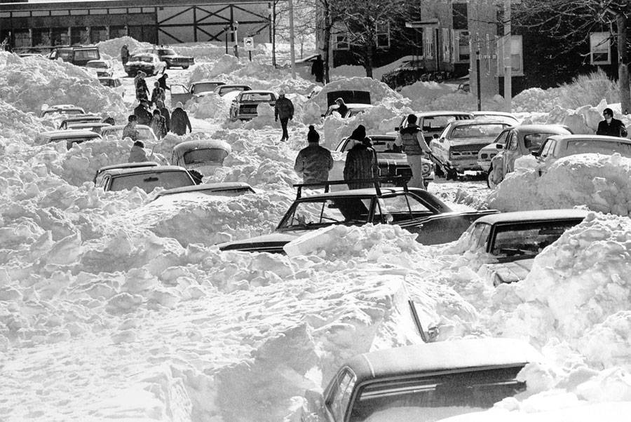
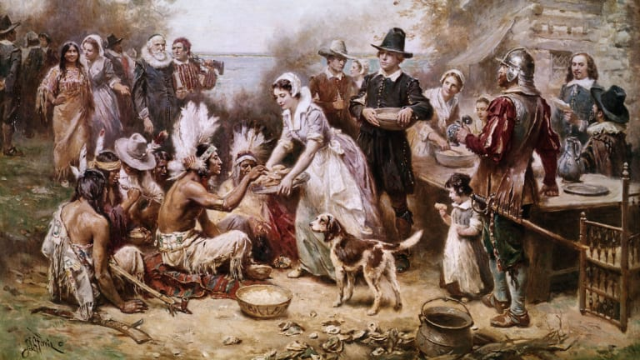
What region are we in?

Slide 24
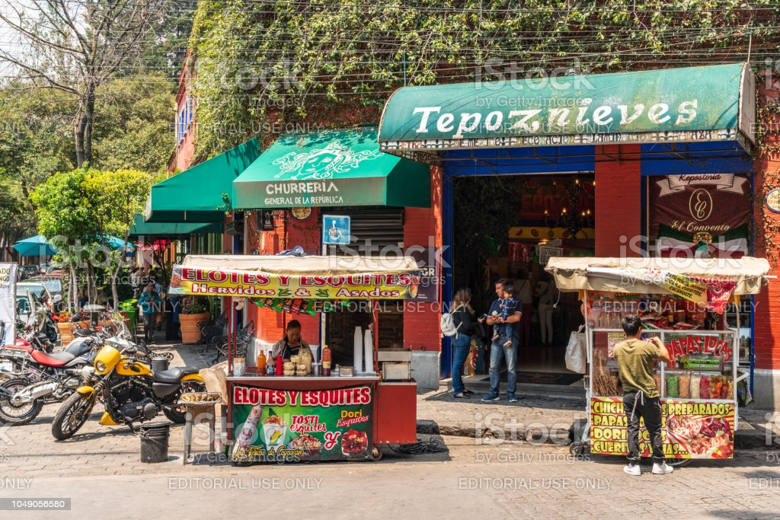
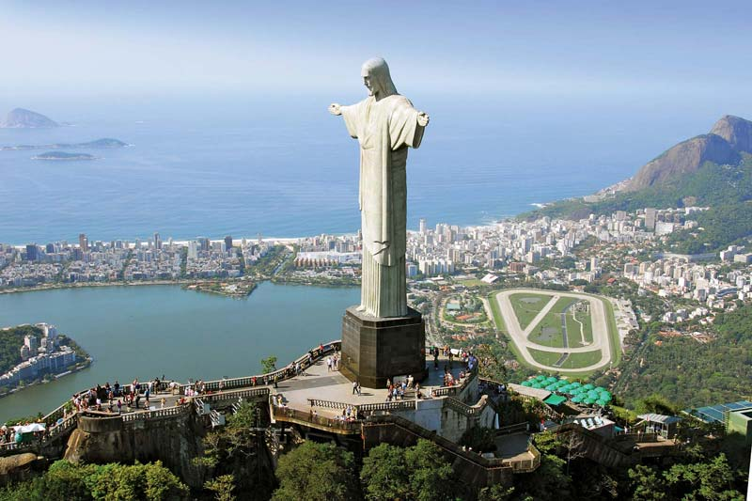

Slide 25
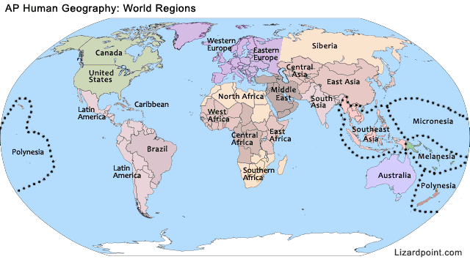

Slide 26
Western Europe
Eastern Europe

Slide 27
Types of Regions
Formal Regions
Similar characteristic or phenomenon
Government/political system
Language, Religion or other cultural traits
Economy
Functional Regions
Defined by their proximity to something
Radio station
Mall
“the financial district”
Perceptual or vernacular region
Exist primarily in an individual’s perception or feelings
“The South”
The Midwest

Slide 28
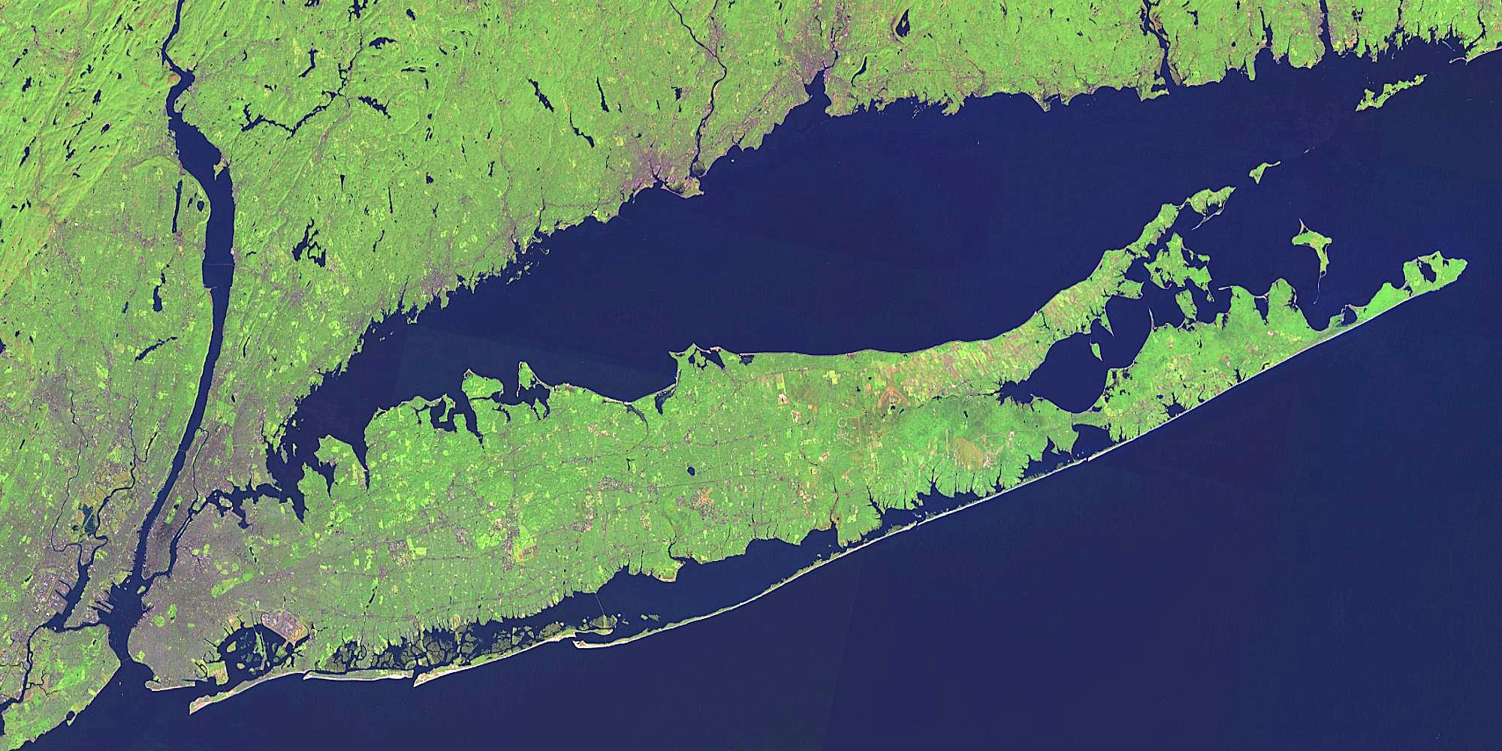
Are there regions of Long Island?

Slide 29
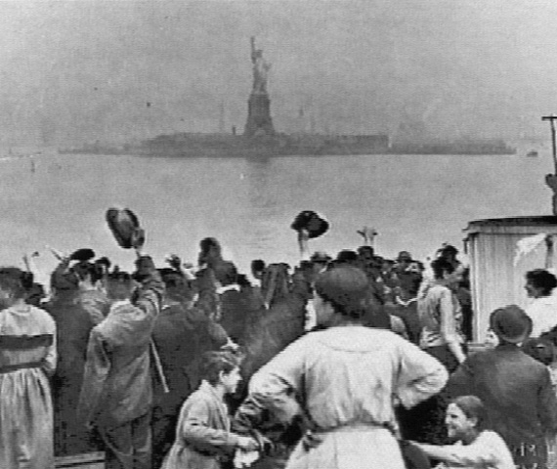
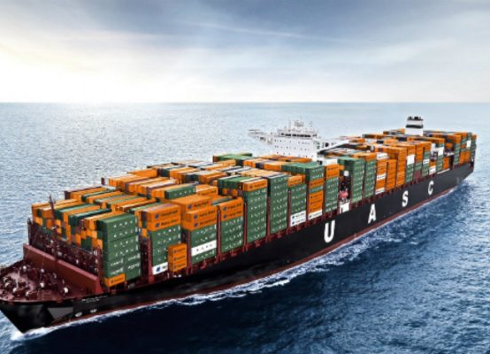
Movement
Migration
Transportation
Communication

Slide 30
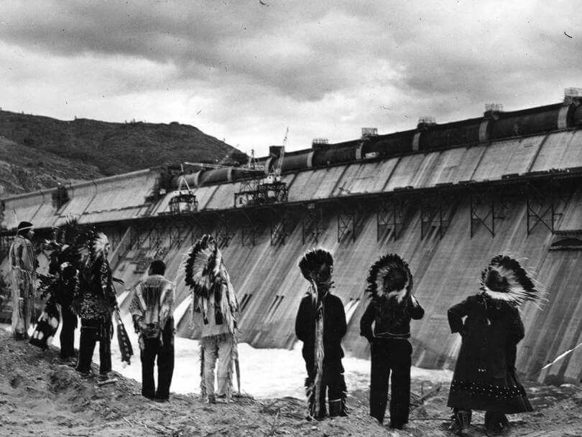
Human-Environment Interaction
Adaptation
Use of Resources
Human Impact

Slide 31
