Slide 1
Cartography
Cartography = the science or practice of making maps
Cartographers must use SCALE and PROJECTION to show places, regions, and locations

Slide 2
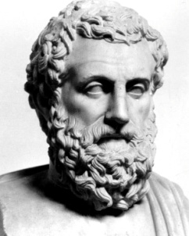
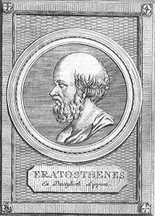
NOTABLE CARTOGRAPHERS
• Aristotle (384 B.C.E – 322 B.C.E)
– Came up with the theory the earth was spherical
• Eratosthenes (3rd Century BCE)
– Calculated the circumference of the earth
– First to use the word Geography

Slide 3
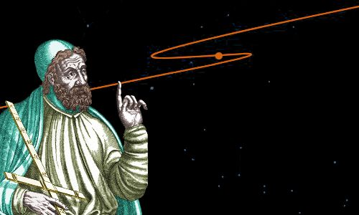
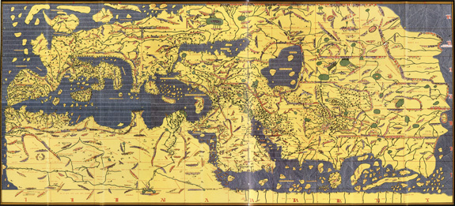
NOTABLE CARTOGRAPHERS
Claudius Ptolemy (CE 90 – CE 168)
Wrote book called Geography and came up with idea of latitude and longitude
Muhammad al-Idrisi (1099-1165)
– Worked for the king of Sicily to make a accurate description of the Earth

Slide 4
What are the challenges of making accurate and useful maps?

Slide 5
MAP FEATURES

Slide 7
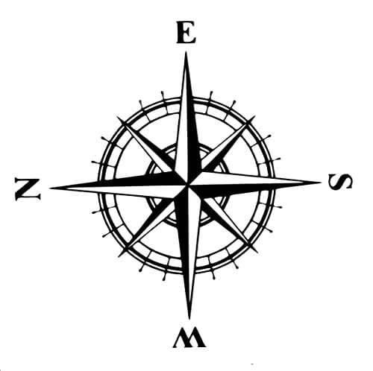
Orientation

Slide 8
Scale
The scale of a map is the ratio of a distance on the map to the corresponding distance on the ground

Slide 9
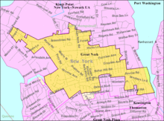
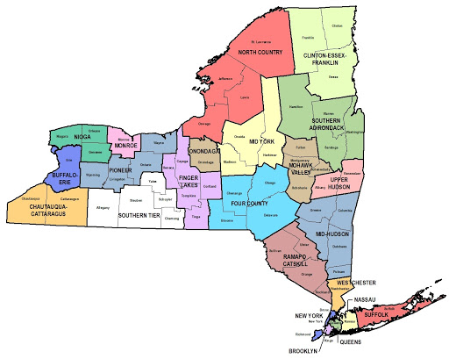
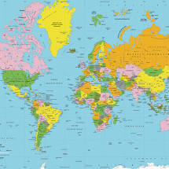
Scale
Local
Regional
Global

Slide 10
Scale Continued
Large Scale
Zoomed in
Small Scale – Zoomed out

Slide 11
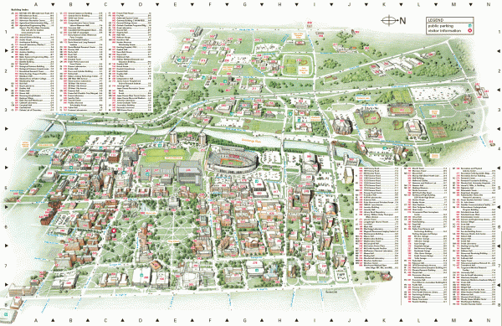
Grid and Index

Slide 12
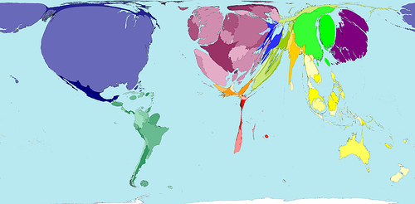
PROJECTION PROBLEMS…
Cartographers have to deal with the problem of making maps of a spherical earth onto a flat surface
Short film on projection
true size of website
– These projections can
lead to DISTORTIONS

Slide 13
Four types of distortions :
1. shape of an area is distorted.
2. distance between two points may increase or decrease.
3. relative size of different areas may be altered.
4. Direction from one place to another can be distorted.

Slide 14
TYPES OF PROJECTIONS

Slide 15
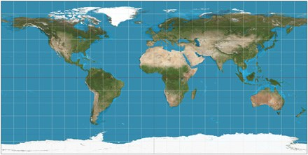
Mercator Projection (Introduced in 1569)
Sphere converted to a cylinder in such a way that all the parallels of latitude have the same length as the equator
https://www.youtube.com/watch?v=KUF_Ckv8HbE

Slide 16
Cons
Distorts the size of land masses and bodies of water the further it is from the equator.
Pros
shapes of landmasses are accurate the closer you are to equator
good for marine navigation because of its ability to represent lines of constant course

Slide 17
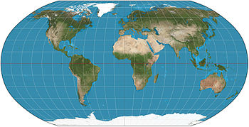
Robinson Projection

Slide 18
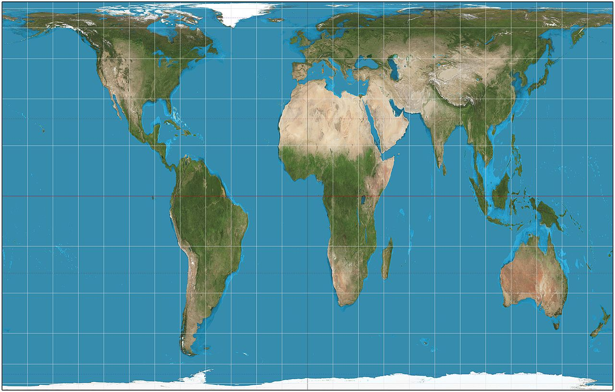
Gall-Peters Projection

Slide 19
Pros – does a good job of showing relative size of places
Cons – greatly distorts shapes – especially at the poles.

Slide 20
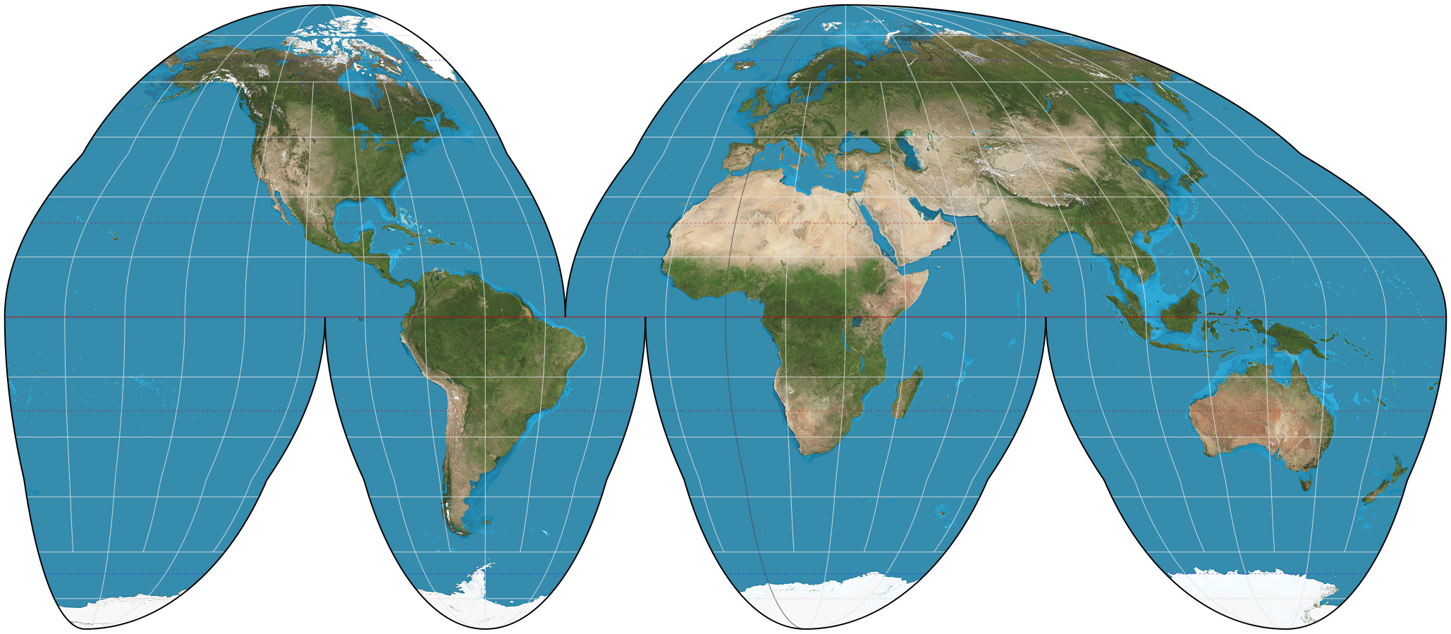
Goode Homosline (Interrupted Projection)

Slide 21
Pros
Shows proper sizes and shapes
Cons
Cannot judge distances between certain places

Slide 22
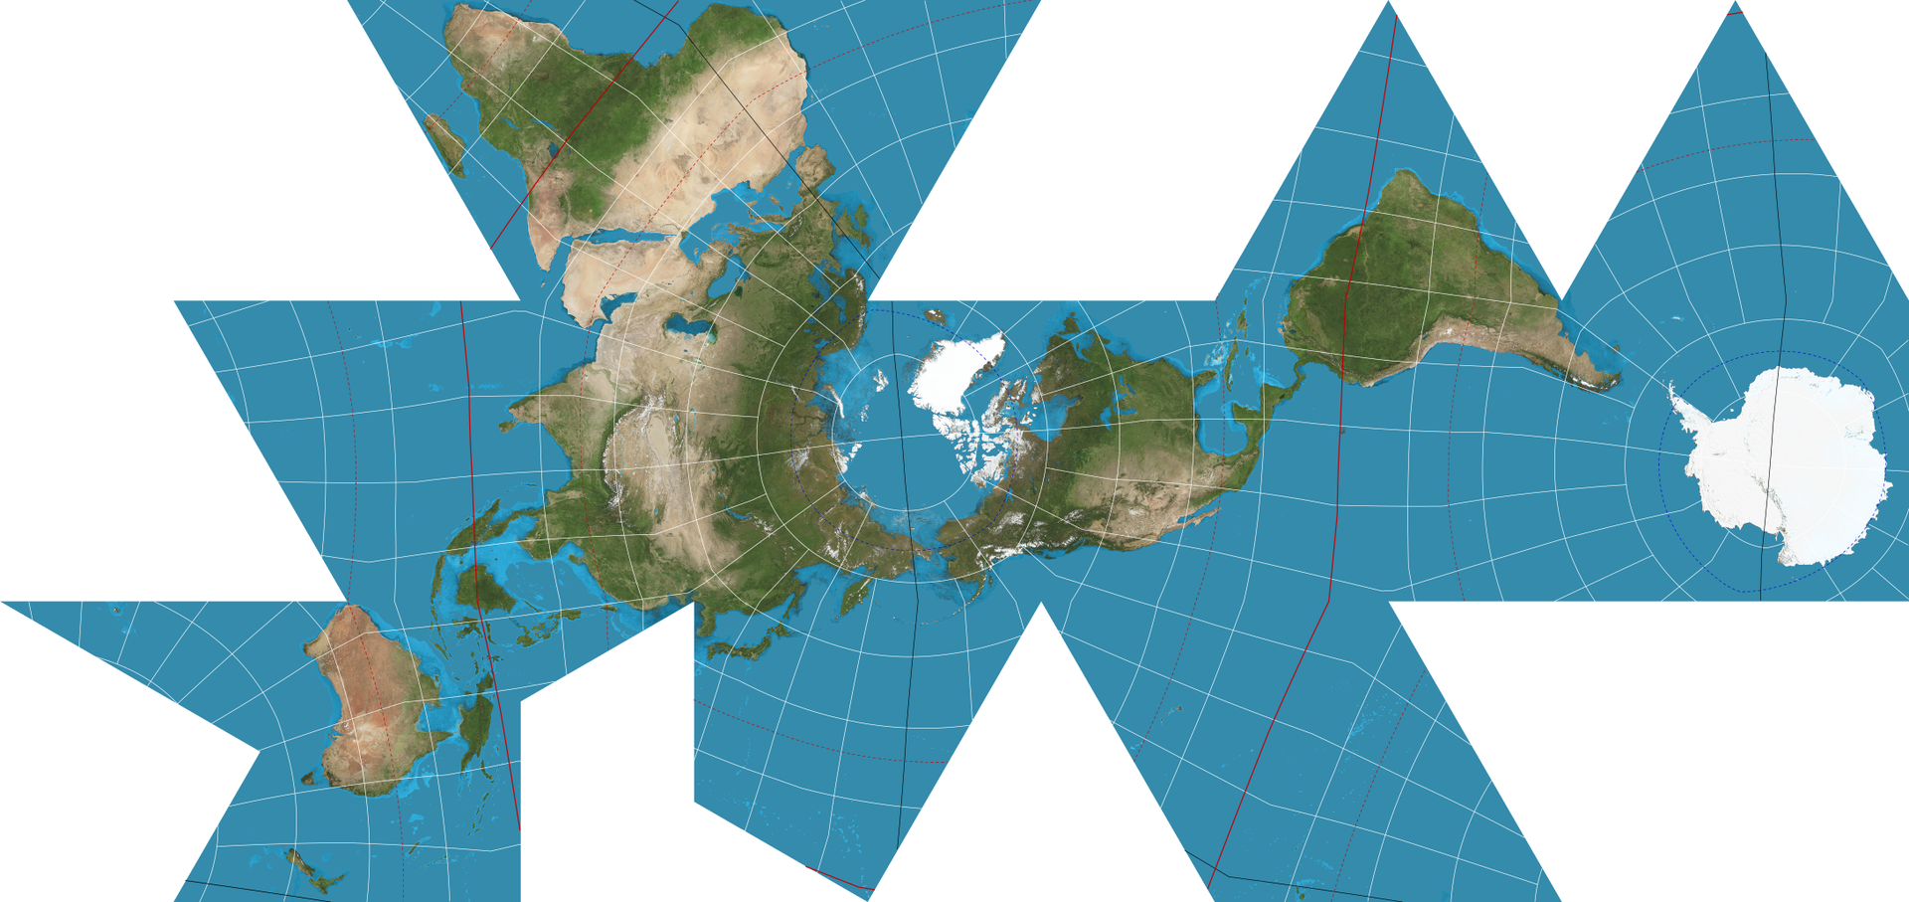
Fuller Projection

Slide 23
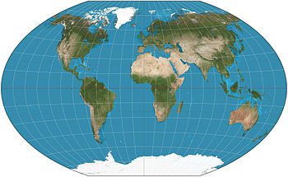
Winkel Tripel Projection

Slide 24
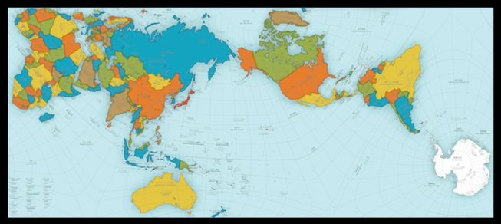
Authagraph
https://www.youtube.com/watch?v=RhAzuuqhMNA

Slide 25
TYPES OF MAPS

Slide 26
Ones you might know….
Physical maps
Topographic maps
Political maps
Climate maps
Road maps

Slide 27
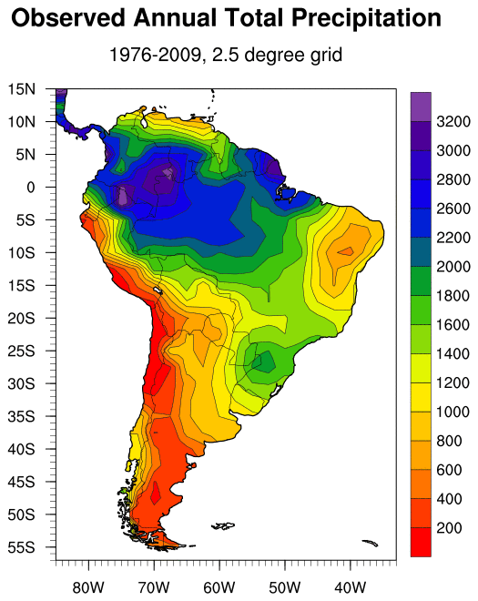
Isoline

Slide 28
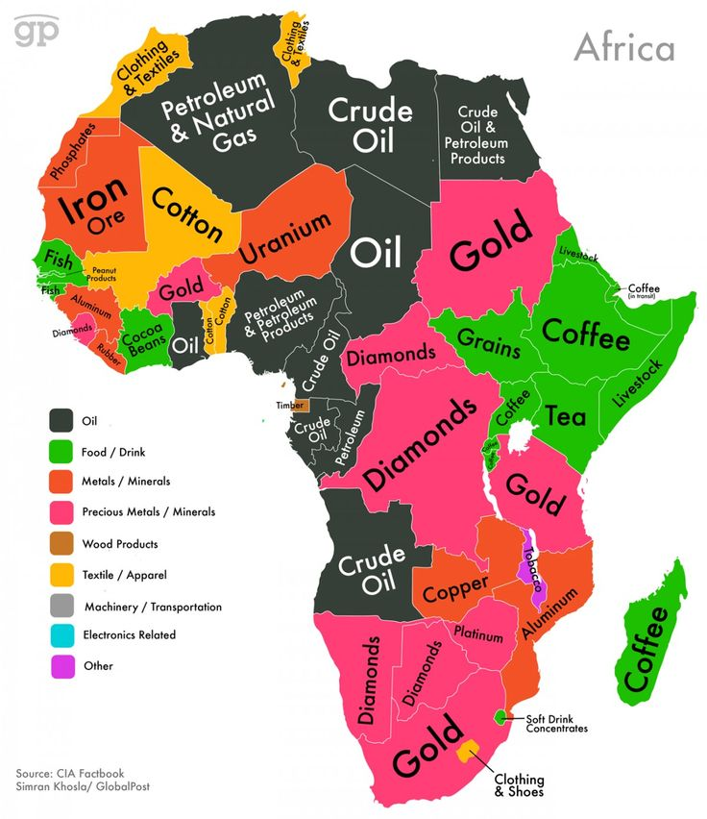
Thematic

Slide 29
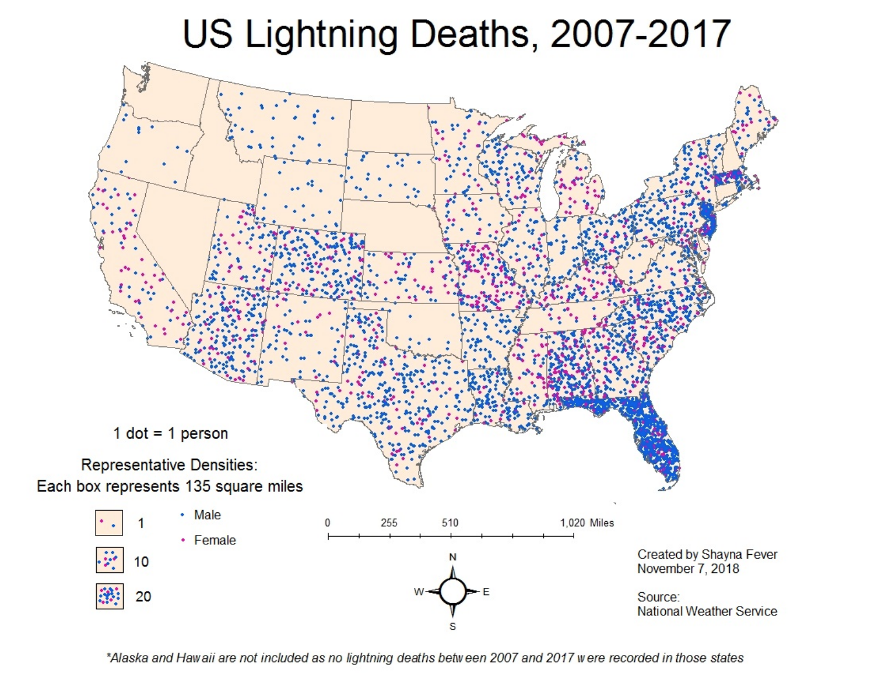
Dot

Slide 30
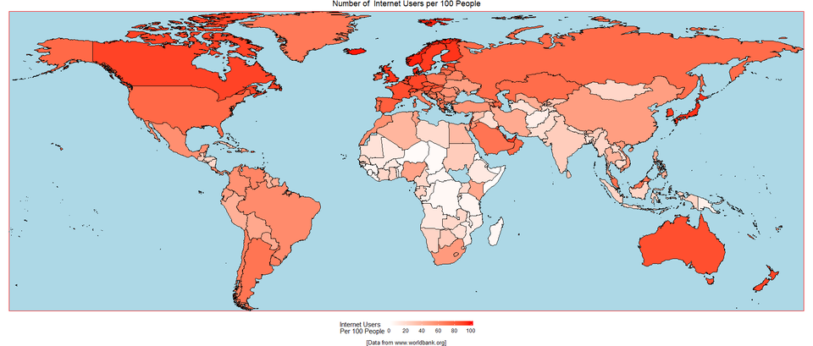
Choropleth

Slide 31
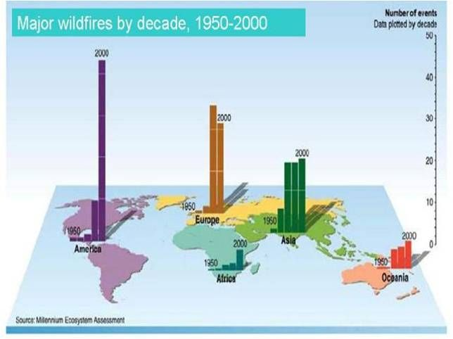
Located Charts

