Slide 1
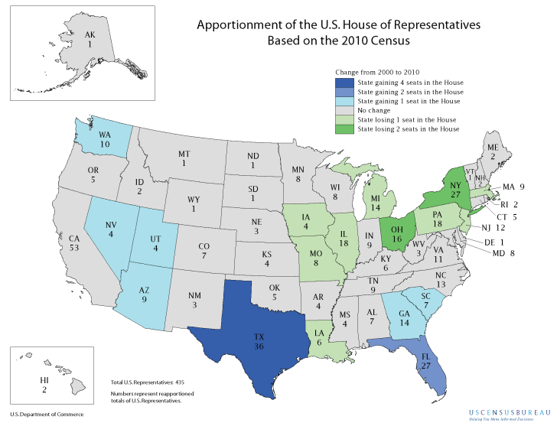

Slide 2
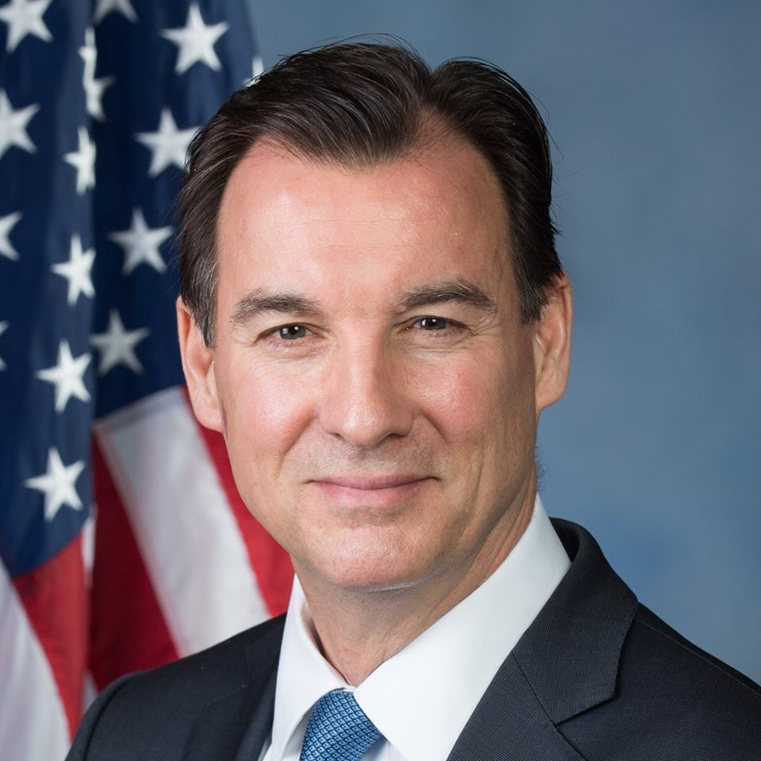
Your Representative
Tom Suozzi

Slide 3
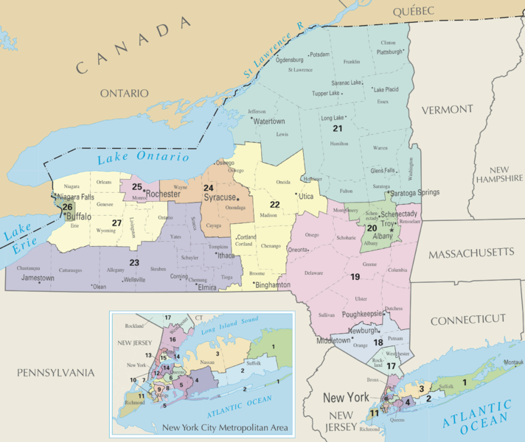
Congressional Districts as a Result of 2010 Census (2013-2022)

Slide 4
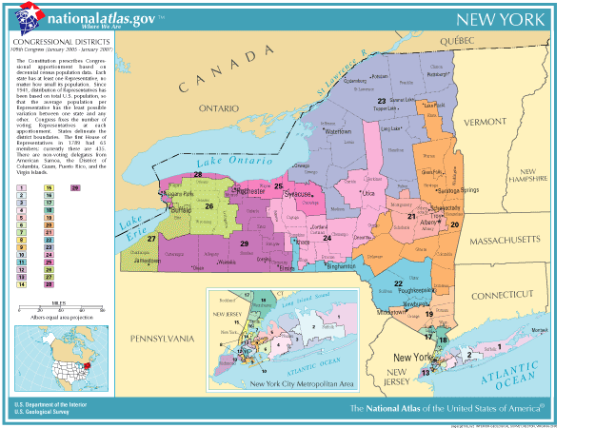

Slide 5
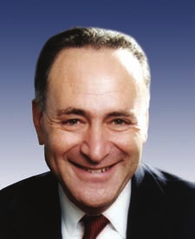
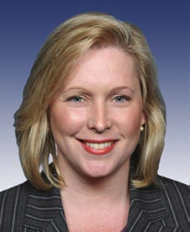
Your Senators
Charles Schumer Kirsten Gillebrand

Slide 6
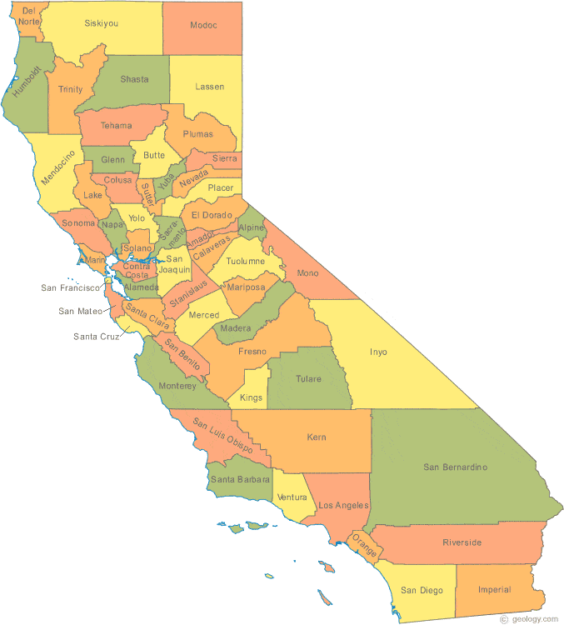
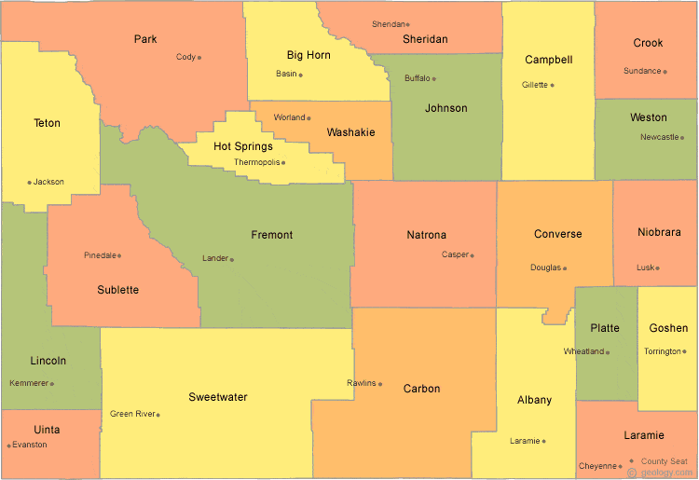
A fair compromise?
Wyoming---568,300
California ---37,342,000
1 senator for every 284,150
1 senator for
every 18,671,000
That means each Wyomin has 67.5 times more representation in the Senate than each Californian!

Slide 7
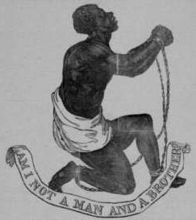
Issue 2: Slaves and Representation

Slide 8
3/5 Compromise
Article 1, Section 2, clause 3
Representatives and direct Taxes shall be apportioned among the several States which may be included within this Union, according to their respective Numbers, which shall be determined by adding to the whole Number of free Persons, including those bound to Service for a Term of Years, and excluding Indians not taxed, three fifths of all other Persons

Slide 9
3/5 compromise
For purposes of representation, 5 slaves would count as 3 free people.
eg.
1 rep. per 60,000 people
180,000 Free + (100,000 slaves x .6) = 240,000 people
State would receive four representatives

Slide 10
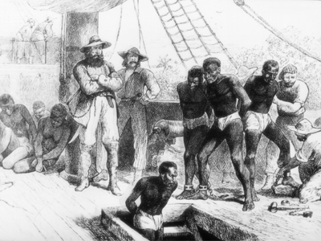
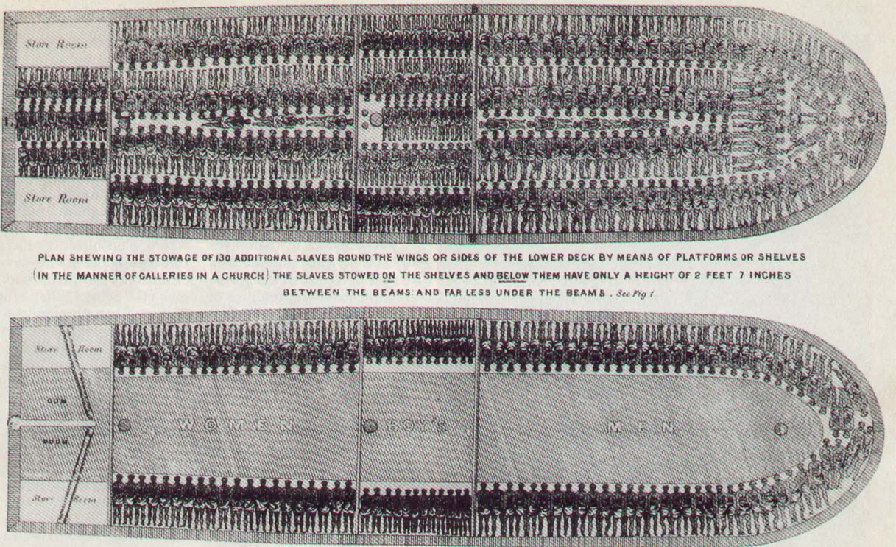
Issue #3 - Slave Trade

Slide 11
Slave Trade Compromise
Article I, Section 9, Clause 1
The Migration or Importation of such Persons as any of the States now existing shall think proper to admit, shall not be prohibited by the Congress prior to the Year one thousand eight hundred and eight, but a Tax or duty may be imposed on such Importation, not exceeding ten dollars for each Person.

Slide 12
Slave Trade Compromise
“Importation” of slaves could be prohibited by Congress after 20 years.
On Jan. 1, 1808 – law went into effect

Slide 13
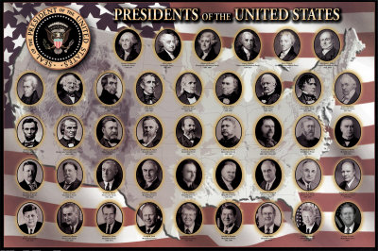
Issue #4 - Electing the President

Slide 14
Electoral College Compromise

Slide 15
Electoral college
http://www.270towin.com/

Slide 16
How it works
New York – 29 Electoral Votes (27 reps. + 2 sens.)
Voters
61% of the Vote
39% of Vote
29 Electors Pledged to support Hillary Clinton
29 Electors pledged to support Donald Trump
Electors supporting Clinton get into the “Electoral College” and are able to cast their votes

Slide 17
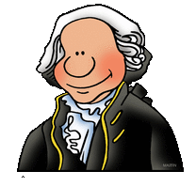
How it originally worked
Each State Legislature chose electors.
Citizens did not have a say.
George Washington and John Adams would be perfect
George Washington and Thomas Jefferson would be perfect
Electors Cast TWO votes for President (No one was actually supposed to run for President - Electors would just think of people they thought would be good for the Job)
Whoever got the most votes would become president; second place finisher became Vice President

Slide 18
Problem?
Rise of political parties complicated things
In 1796 Adams (a Federalist) was elected President and Jefferson (a Democratic-Republican) was elected Vice-President
Election of 1800 was a tie.

Slide 19
12th Amendment
Passed after Election of 1800
Rather than each elector casting two votes for president, would cast one for president and one for vice-president

Slide 20
What if no one gets a majority of electoral votes
House of Reps votes – each state delegation gets one vote.
Happened twice – 1800 and 1824
http://www.270towin.com/

Slide 21
How can someone win popular vote but lose the election?
When has it happened?
1824
1876
1888
2000
2016

Slide 22
Criticisms of the System?
Winner of the popular vote can lose the election
“Winner Takes All system” discourages candidates from campaigning in solidly “Blue” or solidly “Red” states
3. Gives small states disproportionate amount of power – Wyoming – 1 electoral vote for every 170,000 people; California 1 electoral vote for every 600,000 people

Slide 23
The Electoral College
Should it be changed?
Why won’t it be changed any time soon?

Slide 24
Why it will never be changed -
Too many states benefit
Small states have disproportionate amount of power in electing presidents
“Swing States” get a lot of attention and feel as if they are more likely to get favorable attention from presidents

Slide 25
federalism
Definition -

Slide 26
Delegated Concurrent Reserved federal only both states only

Slide 27
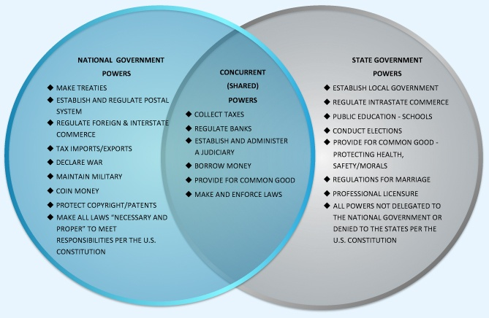

Slide 28
Federalism
Dual
Cooperative
Centralized

Slide 29
Shift of Power from States to Federal Government
By Amendment
Civil War Amendments
13th – ended slavery (which had previously been a state right
14th
Due Process and incorporation clauses
States obligated to honor guarantees in Bill of Rights
Equal Protection clause
15th Amendments
Voting Rights Amendments
15th (blacks); 19th (women); 24th (no poll taxes); 26th (18 year olds)
Direct Election of senators rather than by state legislatures (Senators less likely to protect interests of state governments

Slide 30
Shift of Power from States to Federal Government
By Federal Law
Use of Elastic Clause and Commerce Clause
By giving money (grants-in aid)to states with strings attached
By Supreme Court Decisions
Marshall Court (1801-1835)
Civil Rights
Segregation (1954)
Gay Marriage (2015)

Slide 31
Article I - Congress
Section 8 –
Identify three powers the federal gov’t has under the constitution that it did not have under the AC.
Explain the difference between clause 18 and the foregoing clauses of section 8.
How might clause 18 come into conflict with the 10th Amendment?

Slide 32
Section 9 –
4. What individual rights are protected by section 9?
Section 10
5. What can’t the states do under the Constitution that they were able to do under the articles?

Slide 33
Powers of the Federal Government
Expressed
Implied
Specifically stated in the constitution
Taxes, regulating trade, declaring war
Not specifically stated but suggested
Elastic Clause (Necessary and Proper) –
expands power of government
Must be used with another power

Slide 34
Limits on Federal Power

Slide 35
Limits
Federalism
Separation of powers with checks and balances

Slide 36
Separation of Powers
Executive Branch
Legislative Branch Judicial Branch

Slide 38
What were the motives of the framers of the Constitution?
Some historians have called the constitutional convention a coup d etat? Why?

Slide 39
Was the Constitutional Convention a Coup d etat?
Who attended
55 delegates
53 would be considered “well-to do” – Planters and lawyers
2 small farmers
Who wasn’t there – Sam Adams, Patrick Henry, Thomas Jefferson

Slide 40
New Rules
Disregarded instructions from state legislature
9 out of 13 required to approve new constitution rather than 13 of 13
Deliberations held in secret

Slide 41
Historians views of Framers’ motives
Traditional View
Beard Thesis
Articles of Confederation was greatly flawed, and framers corrected those flaws
Framers were wealthy men who sought to protect their economic interests.
Evidence –
Statements made by delegates (eg. Hamilton)
Specific Powers given to Congress
Structure of government did not allow common folk to have much of a say
Motivated by natural rights philosophy and Classical Republicanism

Slide 42
The Ratification Debate

Slide 43
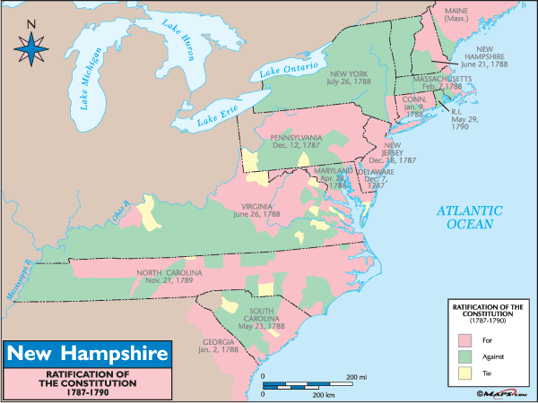

Slide 44
Limits
Federalism

Slide 45
Headlines
Senate Ratifies Trade Treaty With Columbia
House of Representatives
Impeaches President Clinton
Senate Confirms John Roberts as
Supreme Court Chief Justice
President Bush Vetoes’ Energy Bill

Slide 47
Electoral College
Original intent
Today

