Slide 1
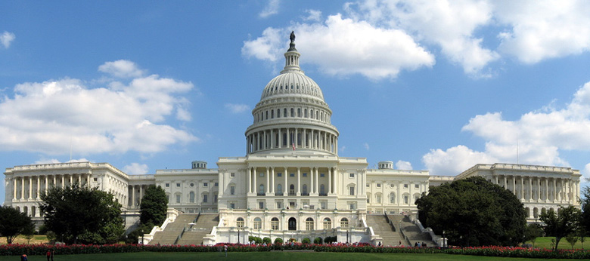
CONGRESS

Slide 2
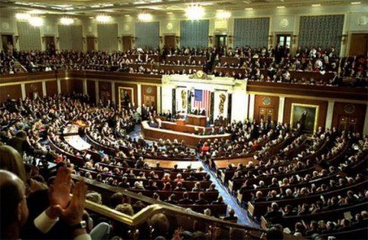
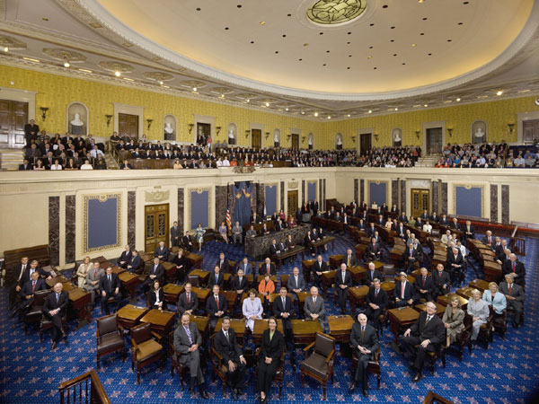
Which House is which?

Slide 3
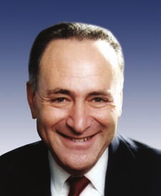
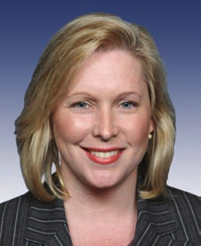
Your Senators
Charles “Chuck” Schumer
Kirsten Gillibrand

Slide 4
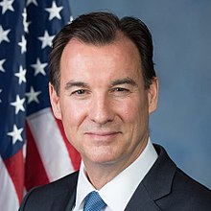
Your Representative
Tom Suozzi

Slide 5
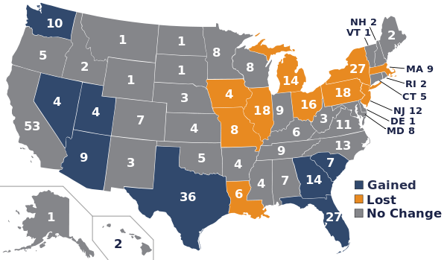
Apportionment for 109th Congress (2013-14)

Slide 6
Reapportionment
Process of determining how many representatives each state receives. Takes place every 10 years after a CENSUS is conducted
Redistricting
Process of redrawing Congressional Districts every ten years to take into account population shifts and changes

Slide 7
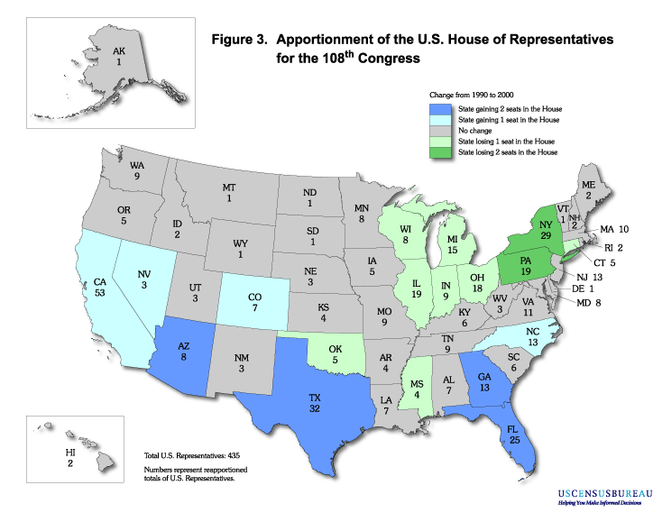

Slide 8
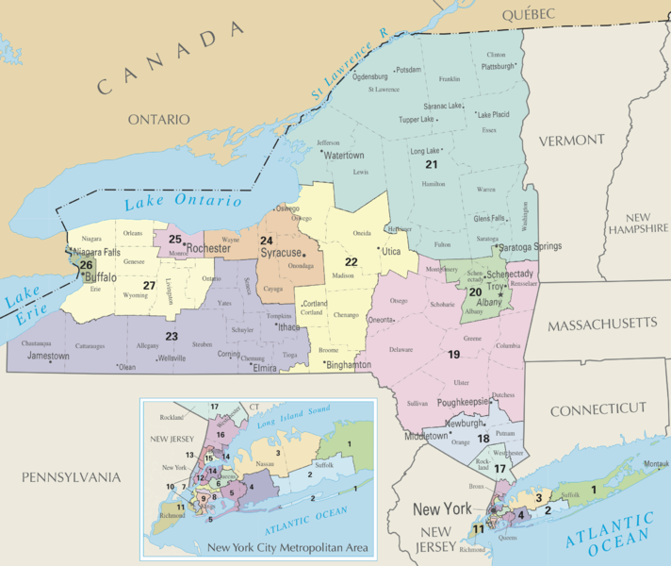
Congressional Districts as a Result of 2010 Census (2013-2022)

Slide 9
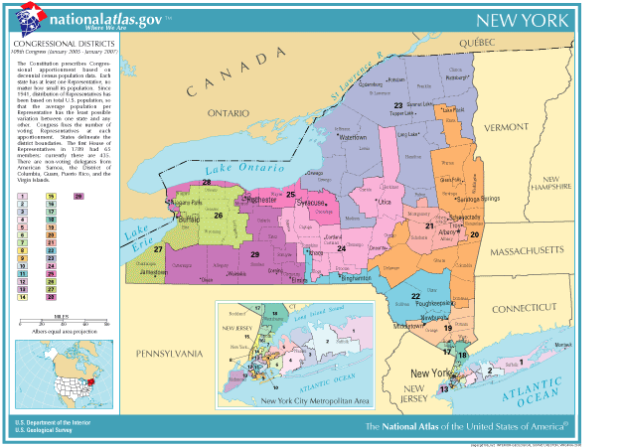
Congressional Districts as a Result of 2000 Census (2003-2012)

Slide 10
New York's Congressmen

Slide 11
H.W. find the following info
1. House of Reps – speaker of the house, majority leader, majority whip, minority leader, minority whip
2. Senate – majority leader, minority leader, President Pro-tempore.

Slide 12
Homework
Define: Gerrymander
Explain the Supreme Court’s decision in the case Shaw v. Hunt (1996).

Slide 13
X=5,000 Residents each district should have 30,000 residents
X X X XX X X
x
XX X X XXX XX
X X X X X
X X X XXX
X X

Slide 14
10 Years later X=5,000 Residents each district should have 35,000 residents
X X X XX X X
XXX
XX X X XXX XX
XXX
XX X X XXX X
XX X X X XXXX
X X X

Slide 15
Draw 8 districts (5 letters per district)
D D D R R R D R D
D R D D R R R R
R R R D R DR RD D D
D R DD D RRR
DD D R

Slide 16
Draw 8 districts so that Democrats win in 6 districts
D D D R R R D R D
D R D D R R R R
R R R D R DR RD D D
D R DD D RRR
DD D R

Slide 17
Draw 8 districts so that Republicans win in 6 districts
D D D R R R D R D
D R D D R R R R
R R R D R DR RD D D
D R DD D RRR
DD D R

Slide 18
John Oliver on Gerrymandering

Slide 20
Bill Becomes Law
Mr. Smith
YouTube - Schoolhouse Rock- How a Bill Becomes a Law

Slide 21
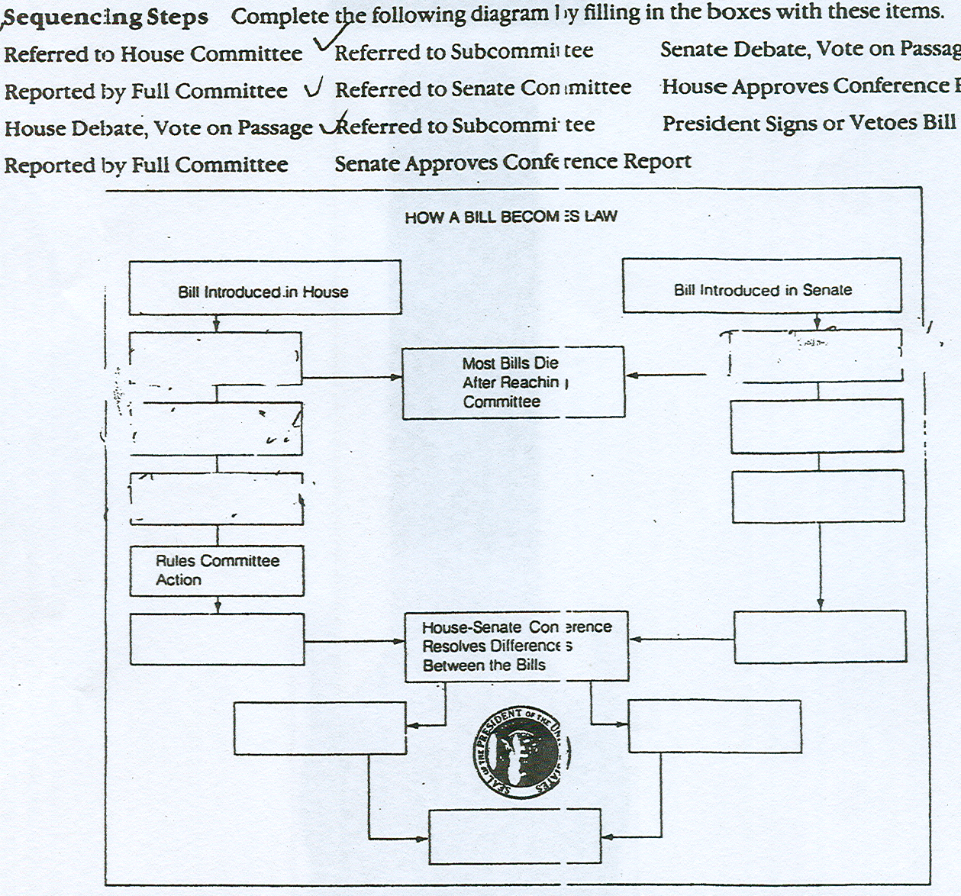

Slide 22
Congressional Leadership and Committee System
congressional leadership
committee hearing

Slide 23
Committee hearing
US Senate Committee on Health, Education, Labor, & Pensions: Hearings - Hearing

Slide 24
Filibuster
filibuster

