Slide 1
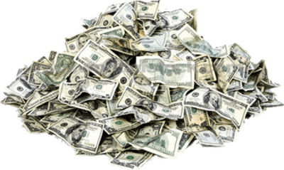
CAMPAIGN FINANCE

Slide 2
PACs
Political Action Committee (PAC) – group organized by industry, company, unions, and other organizations that collect money to give to campaigns
SuperPAC – a not for profit group that is organized to support a particular candidate or issue. People can give unlimited amounts of money and they can spend unlimited amounts on advertising as long as they do not coordinate with the candidate

Slide 3
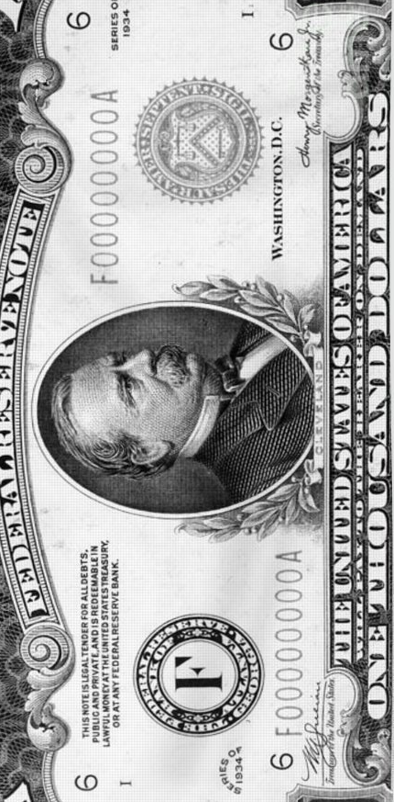
Types of Money
Hard money
Directly given to candidate and used in campaign
Limits imposed by federal law
Soft money
no limits on contribution.
can come from individuals and political action committees, and corporation
can only be used for "party-building activities" such as advocating the passage of a law and voter registration, and not for advocating a particular candidate in an election.
Dark money
Contribution in which the source is not known –

Slide 4
Supreme Court
Citizens United vs. F.E.C. and SpeechNow.org v. FEC.
Declared section of 2002 Campaign finance law unconstitutional
Said groups can advocate on behalf of a candidate up until election day as long as not coordinating with the candidate
Money = speech
Led to expansion of groups known as SuperPacs

Slide 5
SuperPAC v. Dark Money Groups
Super PAC
Regulated by FEC
Can take unlimited contributions and spend unlimited amounts of money
Must disclose donors
Dark Money Groups
Majority of activities cannot involve election campaigns
Can raise unlimited $ and spend unlimited $
Not required to disclose donors

Slide 6
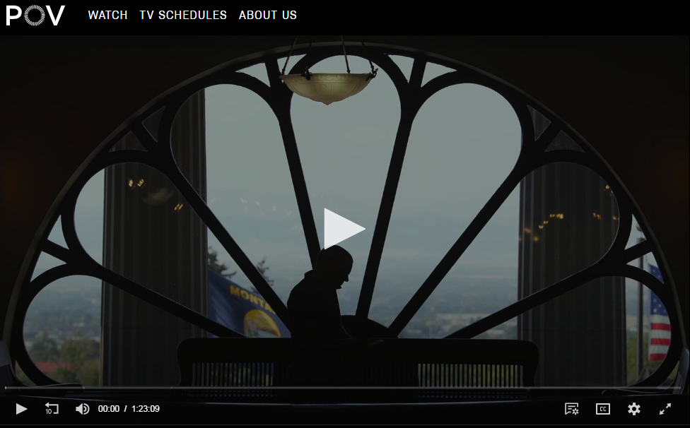
Dark Money - film

Slide 7
Contributions to Campaigns
2012 campaign - Banking on Becoming President | OpenSecrets
2016 campaign

Slide 8
PACS and SUPER PACS
Colbert and Trevor Potter form Super Pac
Colbert a-+nd Potter shell game
Jon stewart handed control of superpac

Slide 9
Propaganda and Political Campaign
Tactics
Name Calling
Glittering Generalities
Transfer
Bandwagon
Card Stacking
Testimonial
Plain Folks
Repetition
Either/or Fallacy
Straw Man Fallacy
Faulty cause and effect
Appeal to authority
Appeal to emotion

Slide 10
Immigration ad
https://adage.com/article/media/watch-disturbing-trump-ad-calls-dems-complicit-murders/312029/

