Slide 1
Affordable Care Act

Slide 2
Poverty Rate
$12,060 for individuals
$16,240 for a family of 2
$20,420 for a family of 3
$24,600 for a family of 4
$28,780 for a family of 5
$32,960 for a family of 6
$37,140 for a family of 7
$41,320 for a family of 8

Slide 3
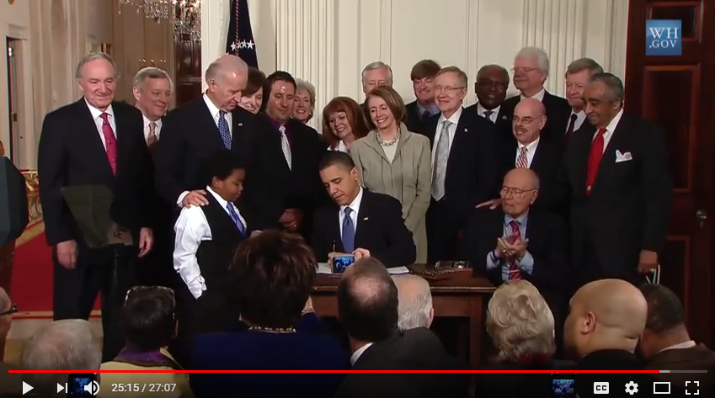
7:10

Slide 4
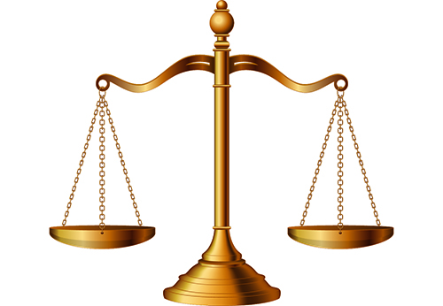
THE AFFORDABLE CARE ACT BALANCING ACT
Individual and Employer Mandate
Coverage of People with Pre-existing Conditions

Slide 5
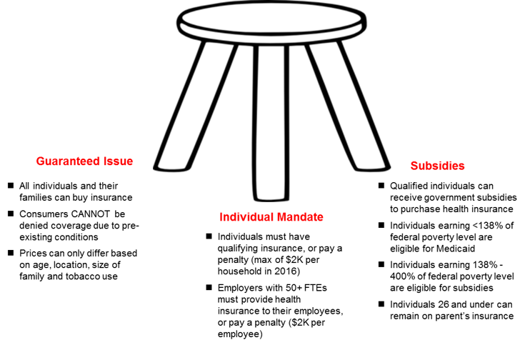

Slide 7
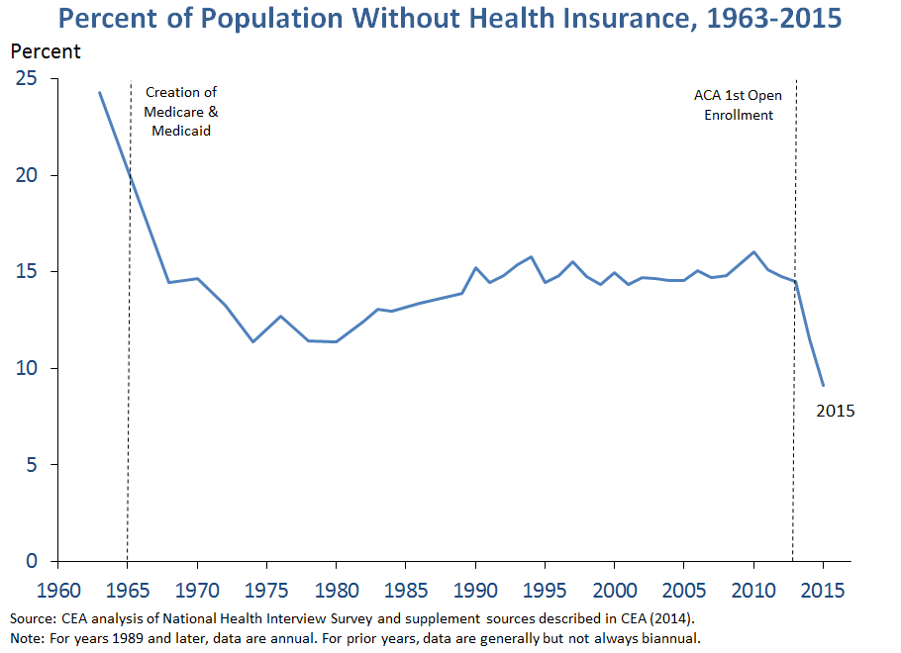

Slide 8
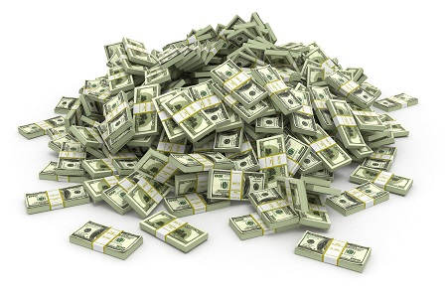
Money and Politics

Slide 9
Special Interest Group
People, organizations, or industry united by a common interest that seeks to influence government through lobbying and campaign contributions

Slide 10
Political Action Committee
Group organized for the purpose of raising and spending money to elect and defeat candidates or in support of or against proposed legislation. Cannot accept contributions over $5,000.

Slide 11
What about outside spending?
Can I spend my own money in support of a candidate or issue?

Slide 12
Citizens United v. FEC
Can government limit outside groups from advertising on behalf of a candidate within 30 days of election?
the Supreme Court held that funding of independent political broadcasts in candidate elections cannot be limited, because doing so would violate the First Amendment. In other words $=free speech

Slide 13
Super Pac
super PACs may raise unlimited sums of money from corporations, unions, associations and individuals, then spend unlimited sums to overtly advocate for or against political candidates or legislation

Slide 14
Issue Advocacy
No limits on spending

Slide 15
PACS and SUPER PACS
Colbert and Trevor Potter form Super Pac
Colbert and Potter shell game
Jon stewart handed control of superpac

Slide 16
Special interest groups and campaign contributions

Slide 17
Contributions to Campaigns
2012 campaign - Banking on Becoming President | OpenSecrets
2016 campaign

Slide 18
Special interest groups and campaign contributions

Slide 19
Healthcare Wars
Harry and Louise – 1993
The Agenda Project - 2010
American Doctors for Truth - 2012

