Slide 1
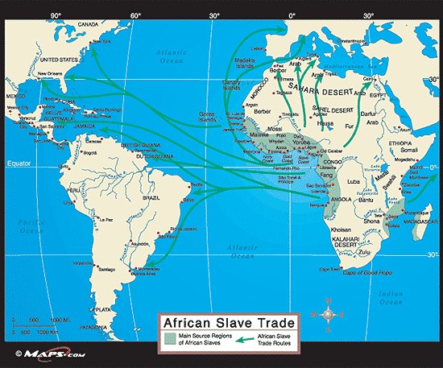

Slide 2
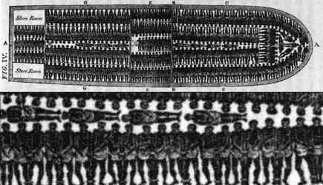
African Slave Trade

Slide 3
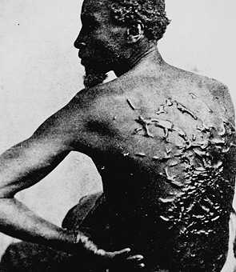

Slide 4
Developments in Slavery
1620 – first Africans brought to Virginia
1660’s – first slave codes passed
1794 – Cotton Gin invented
1800 – Slave Population – 1,000,000
1808 – Importation of slaves from Africa prohibited.
1860 – slave population – 4,000,000

Slide 5
 | 1790 | 1800 | 1810 | 1820 | 1830 | 1840 | 1850 | 1860
All States | 694,207 | 887,612 | 1,130,781 | 1,529,012 | 1,987,428 | 2,482,798 | 3,200,600 | 3,950,546
Delaware | 8,887 | 6,153 | 4,177 | 4,509 | 3,292 | 2,605 | 2,290 | 1,798
Georgia | 29,264 | 59,699 | 105,218 | 149,656 | 217,531 | 280,944 | 381,682 | 462,198
Maryland | 103,036 | 105,635 | 111,502 | 107,398 | 102,994 | 89,737 | 90,368 | 87,189
Mississippi | - | - | - | 32,814 | 65,659 | 195,211 | 309,878 | 436,631
New Jersey | 11,423 | 12,422 | 10,851 | 7,557 | 2,254 | 674 | 236 | 18
New York | 21,193 | 20,613 | 15,017 | 10,088 | 75 | 4 | - | -
Pennsylvania | 3,707 | 1,706 | 795 | 211 | 403 | 64 | - | -
South Carolina | 107,094 | 146,151 | 196,365 | 251,783 | 315,401 | 327,038 | 384,984 | 402,406
Virginia | 292,627 | 346,671 | 392,518 | 425,153 | 469,757 | 449,087 | 472,528 | 490,865

Slide 6
End of Slavery in North
Significant dates | VT | PA | MA | NH | CT | RI | NY | NJ
European settlement | 1666 | 1638 | 1620 | 1623 | 1633 | 1636 | 1624 | 1620
First record of slavery | c.1760? | 1639 | 1629? | 1645 | 1639 | 1652 | 1626 | 1627
Official end of slavery | 1777 | 1780 | 1783 | 1857 | 1784 | 1784 | 1799 | 1804
Actual end of slavery | 1777 | c.1845 | 1783 | c.1845? | 1848 | 1842 | 1827 | 1865

Slide 7
Slaveholders in the South

Slide 8
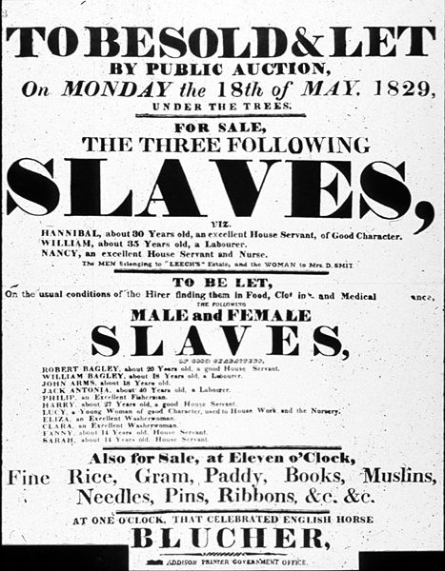

Slide 9
Whom is the poster directed towards?
What message is being conveyed?
Who do you think created the poster?

Slide 10
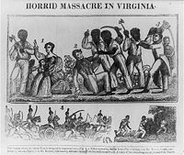

Slide 11
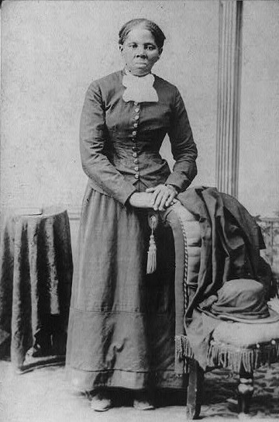
Harriet Tubman

Slide 12
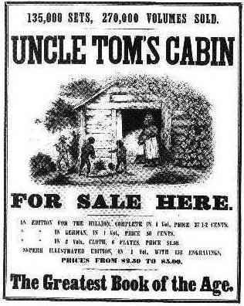
Harriet Beecher Stowe
fsa

Slide 13
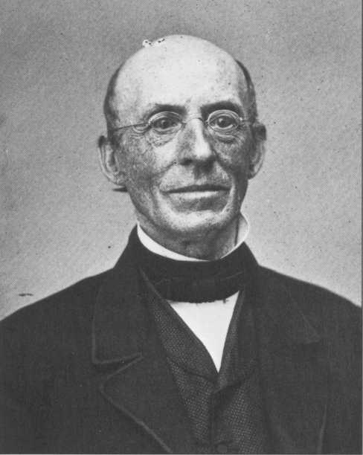
William Lloyd Garrison

Slide 14
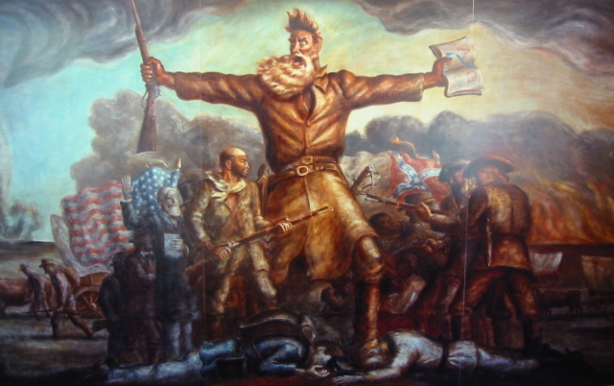
John Brown

Slide 15
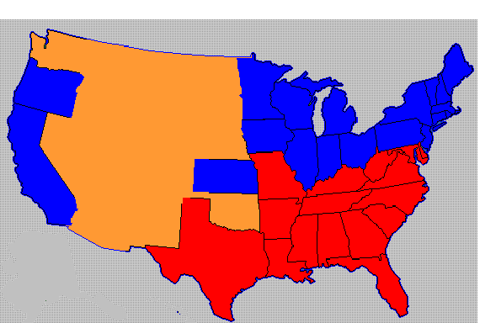
What time period in American history is shown?
What do the different colors represent?
Why would the situation shown lead to disputes within the United States?

Slide 16
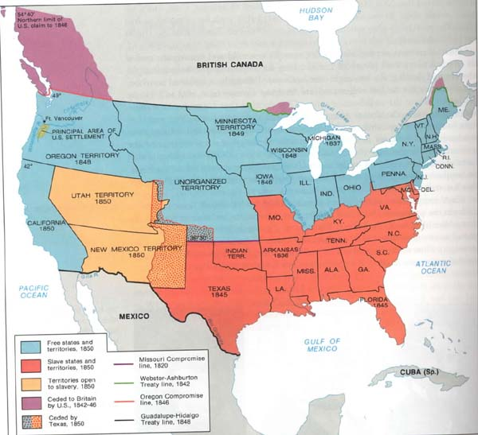
After Compromise of 1850

Slide 17
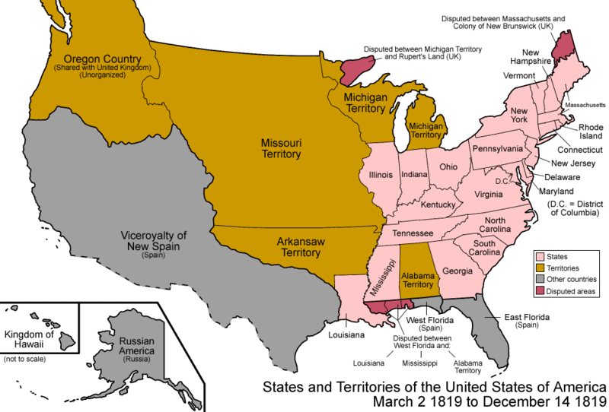
U.S. in 1819

Slide 18
Dispute over spread of slavery
Some northerners opposed slavery on moral grounds
Concern of both north and south was over balance of power in the United States Senate

Slide 19
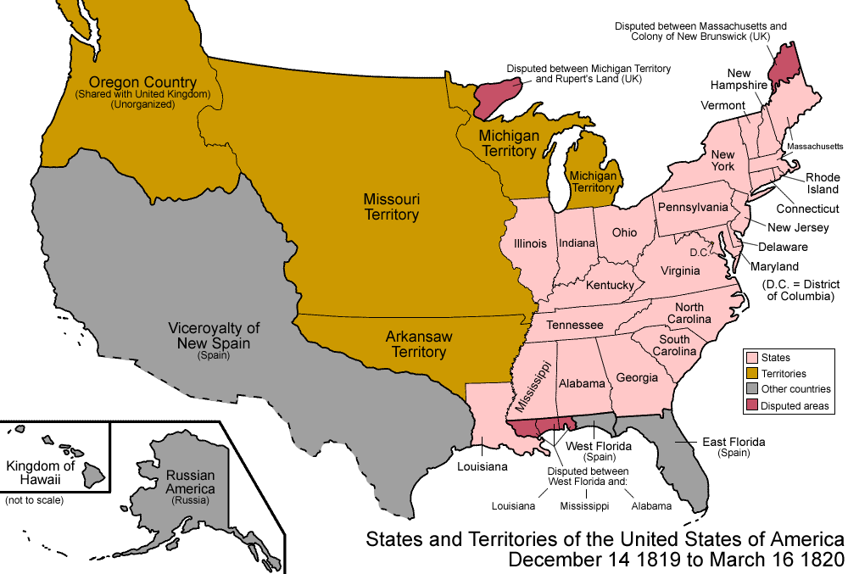
United States in 1819

Slide 20
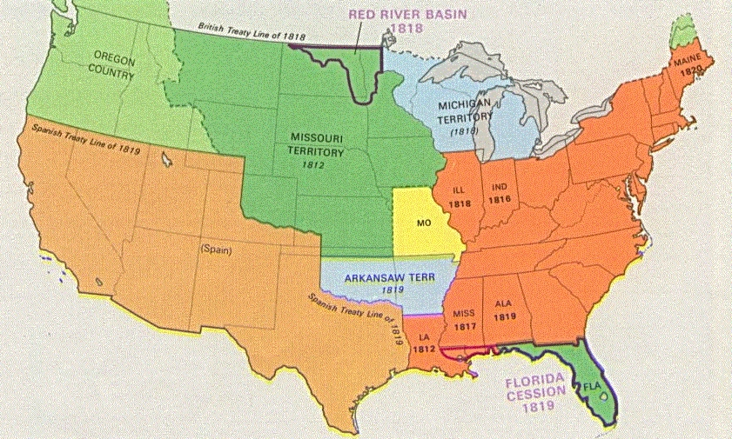
Missouri Compromise

Slide 21
The Missouri Compromise
Missouri admitted as a slave state
Maine – Free State
Territory north of 36 30 latitude in LA Purchase – FREE
South of line - SLAVE

Slide 22
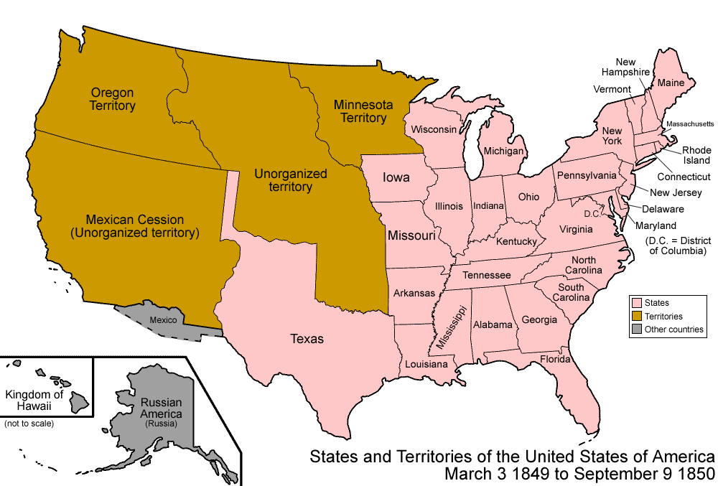
U.S. in 1849

Slide 23
Compromise of 1850
Issues
California applied for admission as a free state
(opposed by south)
What to do about slavery in territory acquired from Mexico (North proposed it be closed to slavery
South was upset about underground railroad and numbers of escaped slaves
Northern abolitionists pushed for end to slavery in Washington D.C.

Slide 24
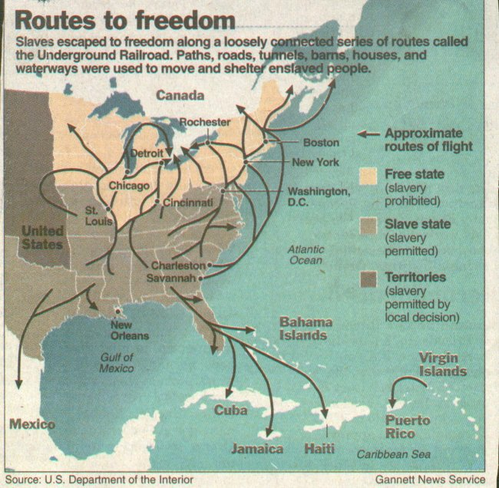

Slide 25
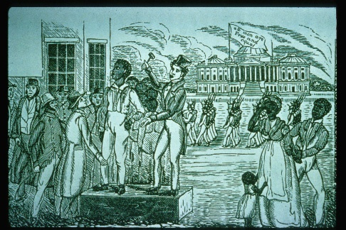

Slide 26
Compromise of 1850
California – Free State
Popular sovereignty in UT and NM territories
Strict Fugitive Slave Act
Slave Trade (but not slavery) abolished in D.C.

Slide 27
Do Now:
Give an example of what you think is an “unjust” law passed recently or in the past.
What are the characteristics of an “unjust” law?
What actions did people take or have they taken in trying to change the law you identified?

Slide 28
Collapse of Compromise

Slide 29
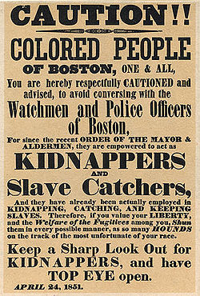

Slide 30
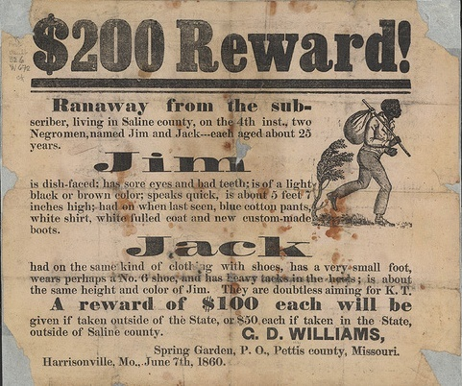
Fugitive Slave Act
Northern Officials forced to assist in capture of alleged fugitives
Imprisonment for those who aided alleged fugitive
No trial by jury or right to testify in self defense.
Claim by slaveholder was enough to make arrest

Slide 31
Northern response to Fugitive Slave act
Civil Disobedience
Organizations formed to obstruct the law
Harriett Beecher Stowe – Uncle Tom’s Cabin
Passage of Personal Liberty Laws – Made it illegal to assist in the capture of escaped slaves

Slide 32
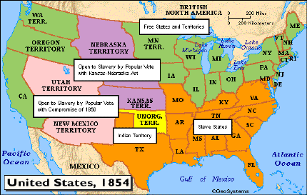
Kansas-Nebraska Act (1854)

Slide 33
Kansas-Nebraska Act and the Collapse of the Missouri Compromise
Kansas-Nebraska Act
Repealed MO compromise
Opened territories of Kansas and Nebraska to slavery through the principle of popular sovereignty
Results
“Bleeding Kansas” – Small scale civil war in Kansas between pro-slavery and anti-slavery forces
“Bleeding Sumner” – beating of Senator Sumner
Birth of the Republican party

Slide 34
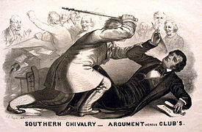

Slide 36
Collapse of the Compromise of 1850

Slide 37
Martin Luther King Jr.
“A just law is a man-made code that squares with the moral law or the law of God. . . Any law that uplifts human personality is just. Any law that degrades human personality is unjust. All segregation statutes are unjust because segregation distorts the soul and damages the personality.”

Slide 38
Dred Scott Decision
black Americans, enslaved or free not citizens; therefore could not sue in federal court
Missouri compromise unconstitutional. Neither Congress nor territorial legislatures could prohibit slavery in territories – violated 5th amendment property rights of slave holders

Slide 39
John Brown
John Brown's Raid in American Memory - YouTube (VA historical society)
West Virginia PBS – start at 13 minutes.
Pete Seeger John Brown s body - YouTube

Slide 40
John Brown “Raid on Harper’s Ferry

Slide 41
The Road to Secession, 1850-1860
Law/Action
Impact
Introduced Popular Sovereignty; fugitive slave act
Northerner did not accept – personal liberty laws, civil disobedience
Bleeding Kansas; Formation of Republican Party; beating of Charles Sumner
Benefited South and outraged northern abolitionists
Increased southern suspicion of northern motives
Compromise of 1850
Fugitive slave Act
Kansas – Nebraska Act
Dred Scott Decision
John Brown’s Raid on Harper’s Ferry

Slide 42
Election of 1860
http://www.270towin.com/

Slide 43
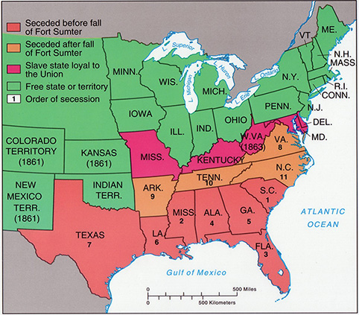
Order of Secession

Slide 44
