Slide 1
Political Quiz Personal Issues
(Choose A if you agree, M for Maybe, D if you disagree.) | A | M | D
Government should not limit speech, press, media or Internet.
Men and women should have the same opportunities and roles in the military.
Gay Marriage should be allowed.
Repeal laws prohibiting adult possession and use of Marijuana.
A woman’s access to abortion should be legal.
Economic Issues
(Choose A if you agree, M for Maybe, D if you disagree.) | A | M | D
Businesses should be free to operate without government regulations.
Only private companies should provide health insurance. Government should not.
Let people control their own retirement; eliminate Social Security and end social security taxes.
Government welfare programs should be ended. There should only be private charity.
Cut taxes and government spending by 50% or more.

Slide 3
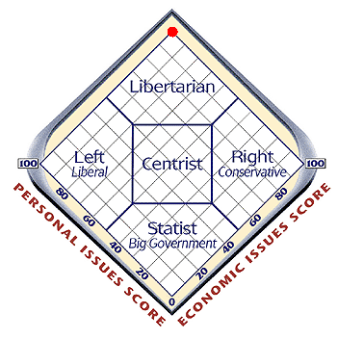

Slide 4
What is a political party?
Organization of people united by common ideological principles that seeks to
Run candidates for office
Win elections
Control government

Slide 5
Are parties a good or bad for democracy?
BAD
GOOD
James Madison – Federalist 10 and
- Parties/factions put self-interest above the national interest
- Clarify choices for voters
- Get people involved in political process
- Provide a vehicle for people to have like-minded people win elections and control government
George Washington – Farewell Address – unprincipled people will use parties as a vehicle to gain power
Patronage and Cronyism – giving jobs to certain groups of supporters to maintain support

Slide 6
George Washington on Parties
"However [political parties] may now and then answer popular ends, they are likely in the course of time and things, to become potent engines, by which cunning, ambitious, and unprincipled men will be enabled to subvert the power of the people and to usurp for themselves the reins of government, destroying afterwards the very engines which have lifted them to unjust dominion."

Slide 7
How many political parties are there?

Slide 8
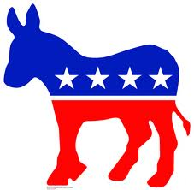
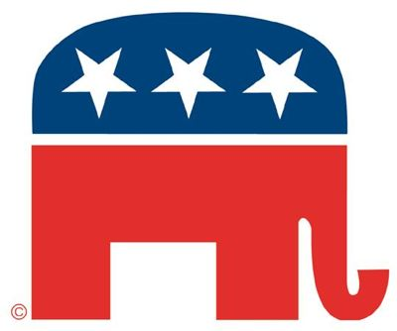
Why do we have a “Two Party” system?

Slide 9
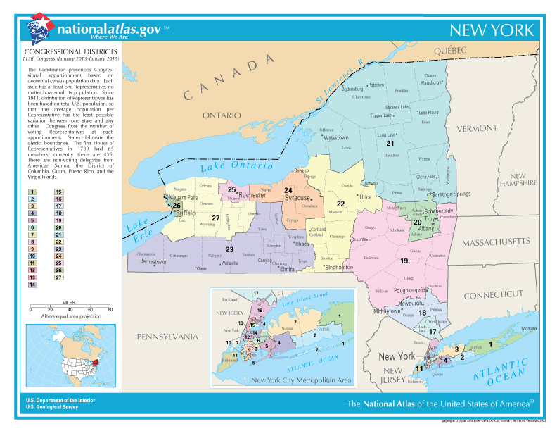
Reason 1 – District representation

Slide 10
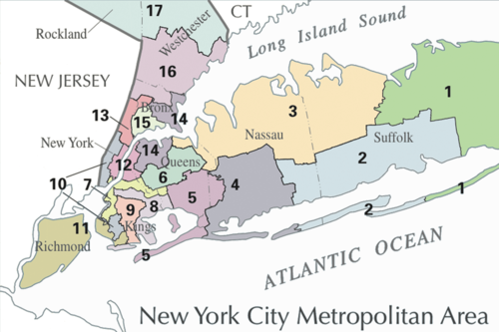

Slide 11
Countries with multi-party systems typically have Proportional Representation
People vote for a party to represent their ideology rather than someone to represent their geographic area
The party gets a number of seats based on % of vote it receives
EXAMPLE 200 seats in legislature
Conservative Party - 40% of vote –
Liberal Party – 35% of vote –
Socialist Party – 13% of vote –
Nationalist Party – 12% of vote -

Slide 12
District Representation
People elect individual representatives to represent their geographic area
Winner takes all – in other words, you get nothing for finishing in second or third place.
People don’t want to waste vote on someone who doesn’t have a chance of winning. They sometime will vote for a candidate not who is not their top choice but who has a chance to win.

Slide 13
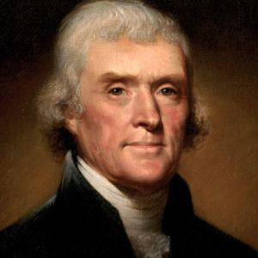
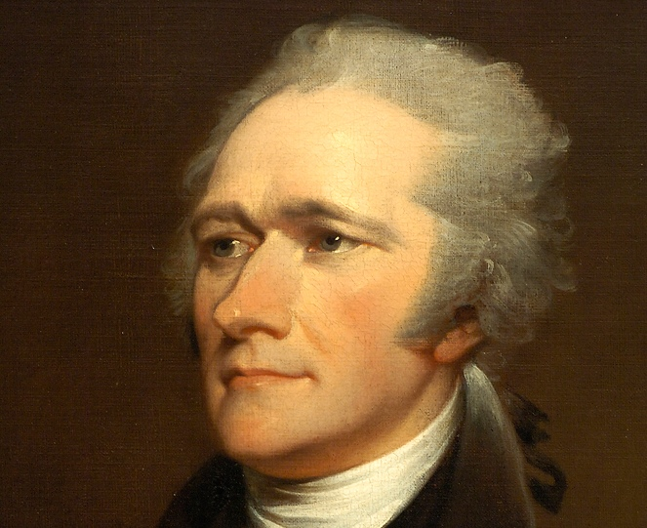
2nd Reason
Tradition – from country’s origins have had a two party system – one representing “conservative” ideology, the other “liberal”

Slide 14
3rd Reason
U.S.A. tends to be a politically centrist or moderate country as you guys demonstrated the other day in the political quiz

Slide 15
Political Parties and Region
https://www.270towin.com/

Slide 16
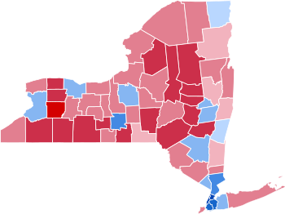

Slide 17
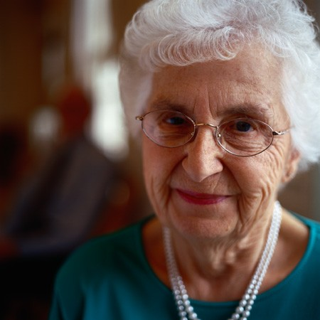
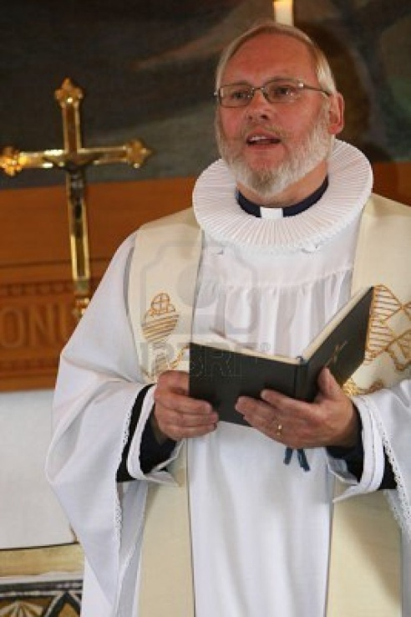
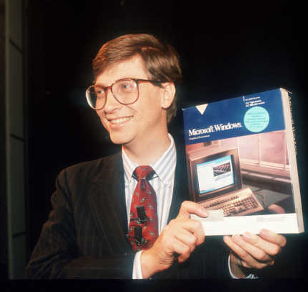
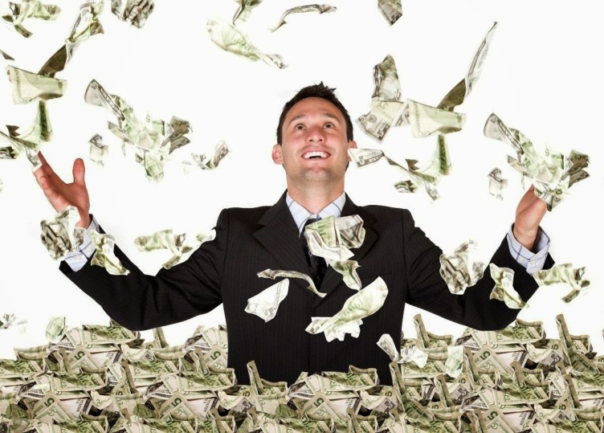
Democrat or Republican?

Slide 18
Who is likely to vote Democrat or Republican?
2016 exit polls
Democrat
Republican

Slide 19
Homework Assignment
Ask your parents, “What’s the difference between a Democrat and a Republican.”

Slide 20
Democratic and Republican Economic Philosophies Compared
President Obama Speaks on the Economy - Osawatomie Speech, Dec. 6, 2011
C-SPAN: President Reagan 1981 Inaugural Address - YouTube

Slide 21
Propaganda and Political Campaign
Tactics
Name Calling
Glittering Generalities
Transfer
Bandwagon
Card Stacking
Testimonial
Plain Folks
Repetition
Either/or Fallacy
Straw Man Fallacy
Faulty cause and effect
Appeal to authority
Appeal to emotion

Slide 22
What’s the propaganda tactic
Mitt Romney – Libya
The Living Room Candidate

Slide 23
Bush 9/11 speech
https://www.youtube.com/watch?v=0wPuY5hI96U

Slide 24
Campaign Advertising
http://www.livingroomcandidate.com/
Pete Hoekstra Political Ad

Slide 25
Elections
Presidential Election Interactive Map and History of the Electoral College

Slide 26
Nader on 2000 Election
Ralph Nader on Independent Candidates and the 2000 Election

Slide 27
A New Third Party?
Tax Day Brings Out "Tea Party" Protesters - CBS News

Slide 28
Party Identification
Party Identification Trend - Pew Research Center for the People & the Press

Slide 29
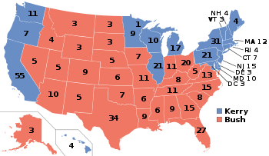
2004 Election

Slide 30
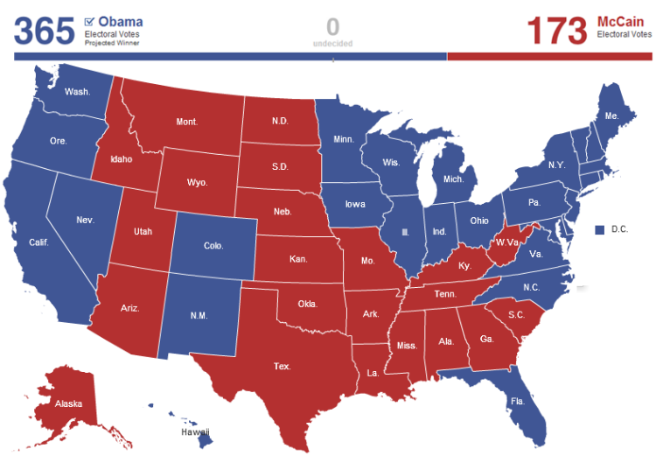
2008 Presidential

Slide 31
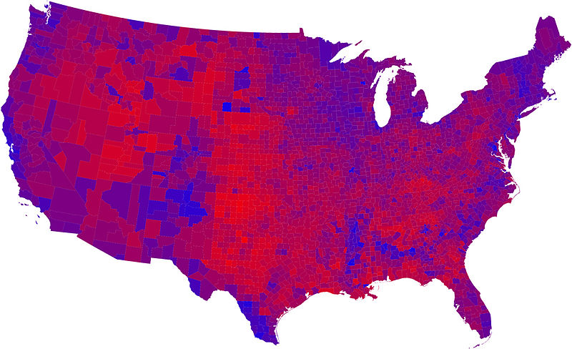
Democratic and Republican Voting – 2008 Presidential Election

Slide 32
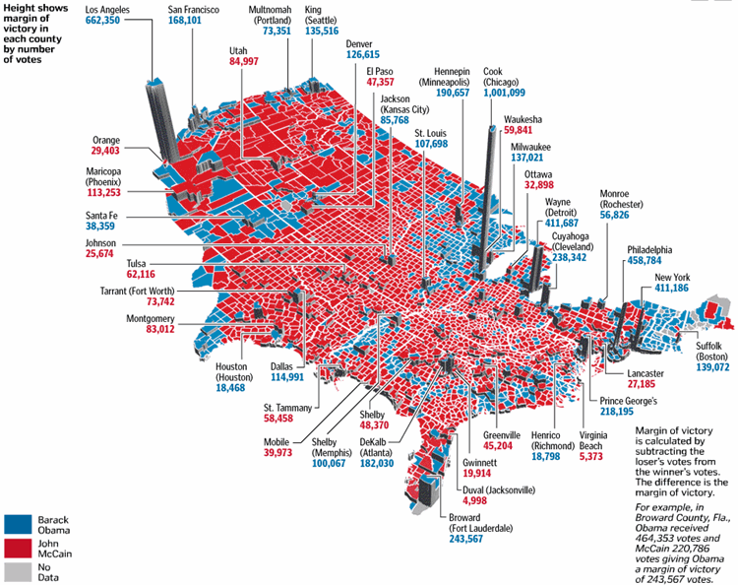
Results by County

Slide 33
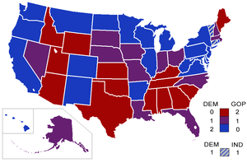
Senate Seats

Slide 34
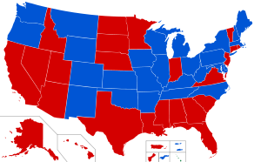
Governors

Slide 35
2004 Presidential Election Exit Poll

Slide 36
2008 Exit poll
Exit Polls - Election Results 2008 - The New York Times

Slide 37
Nominating Process
How long does the nominating process last?
What do the first three states have in common?
On what date are the most delegates chosen?
What is the difference between “proportional” and “winner takes all”? “Unbound” and “bound” delegates? “Open” and “closed” primaries?

