Slide 1
What is Economics?
mrmaddenswebsite.weebly.com

Slide 2
What is economics?
Economics
Study of how societies individuals, governments, families, businesses, etc. deal with the condition of scarcity
Scarcity – condition of there being not enough resources to satisfy our wants.
In other words – study of how societies try to satisfy their wants with limited resources

Slide 3
Economy
how a society/country/area tries to satisfy its wants with limited resources
Economize
trying to get the most out of your resources in order to satisfy your wants

Slide 4
I really want to do well on Monday’s test but there is that Justin Bieber Concert I want to go to and then there is that I-phone I wanted to get and I also feel as if I’m coming down with a cold or something. Oh dear what do I do?

Slide 5
Hmm – I want our country to be a land of small farmers but I look at the map and we are running out of room. I also would like to produce more crops at Monticello so I can pay for my expensive habits but I don’t have the resources to do so. Oh dear!

Slide 6
Do now
Write down three ways that you or your family had to deal with the issue of scarcity in the last week.

Slide 7
FACTORS OF PRODUCTION

Slide 11
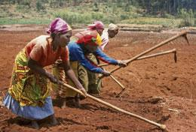
-Which Factors of Production seem to be lacking? -What could be done to address scarcity in that resource

Slide 12
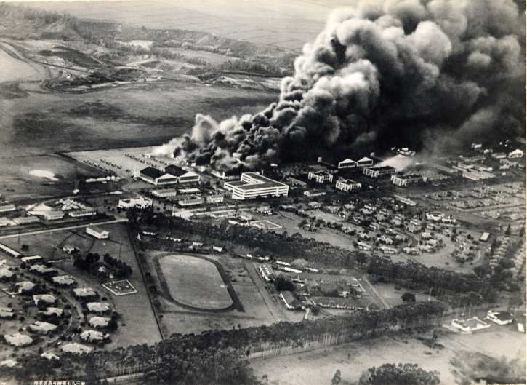
What’s being shown? Why did it happen?

Slide 13
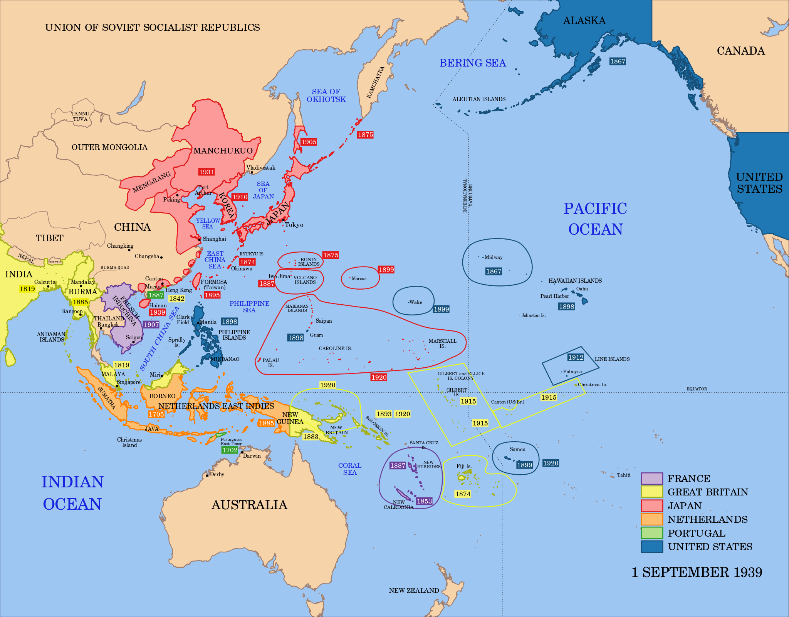

Slide 14
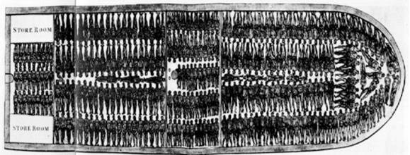
What is this a picture of?
Explain TWO ways in which it illustrates the problem of scarcity.

Slide 16
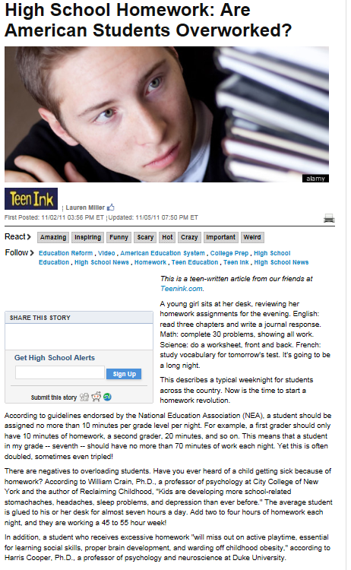

Slide 17
