Slide 1
Identify two different economic systems
Define them
In what countries do they exist?

Slide 2
Economic Systems
How a society organizes itself to satisfy its wants with limited resources
THREE ECONOMIC SYSTEMS
Market Economy
Traditional Economy
Command Economy

Slide 3
Three Economic Questions
What will be produced?
How will it be produced?
Who will receive what is produced?

Slide 4
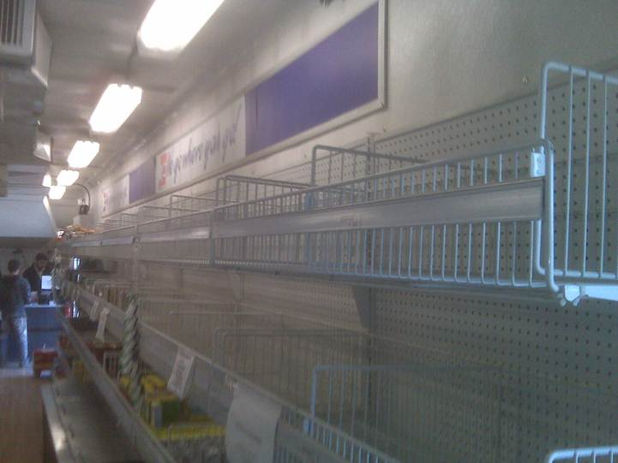
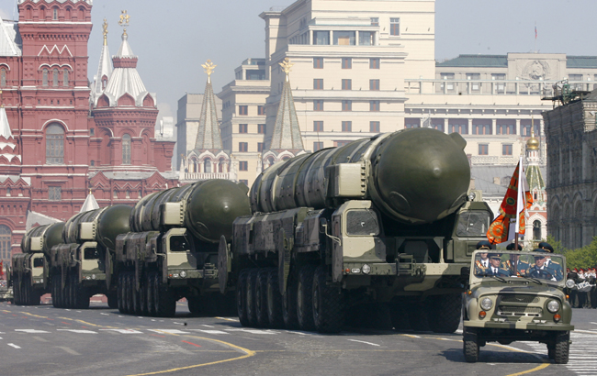
What will be produced?
eg. Command Economy

Slide 6
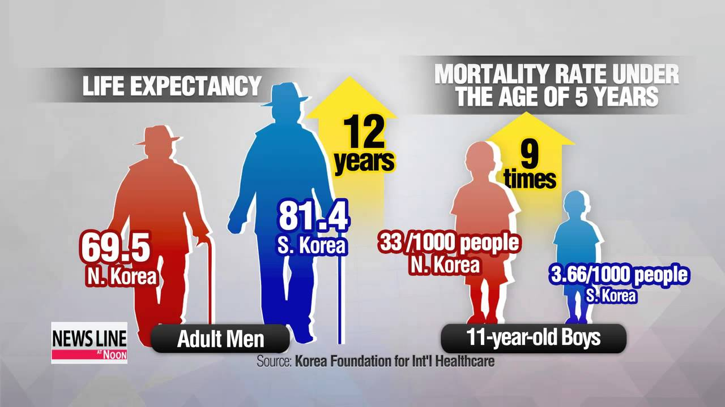
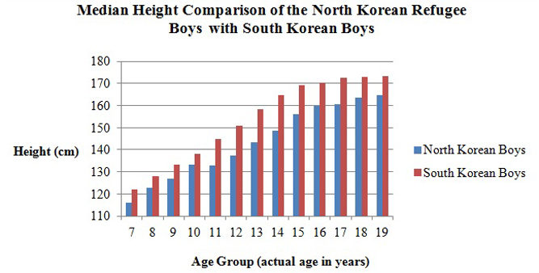

Slide 7
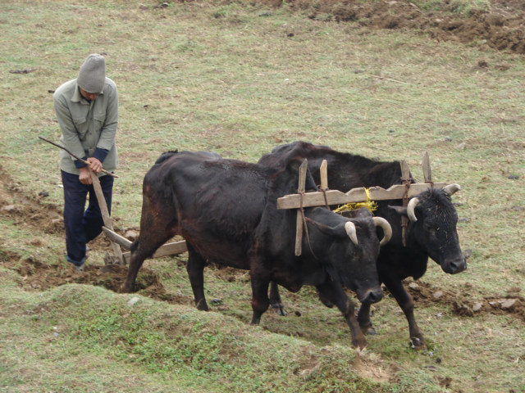
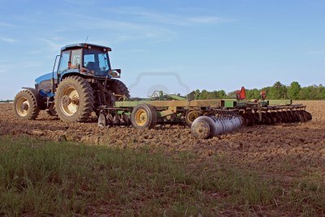
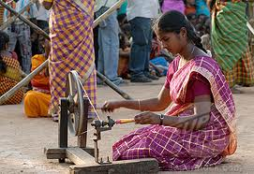
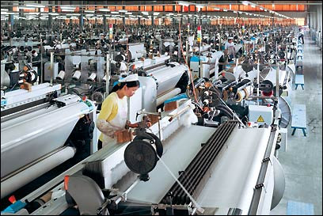
How will it be produced?
eg. Traditional Economy v. Market Economy

Slide 8
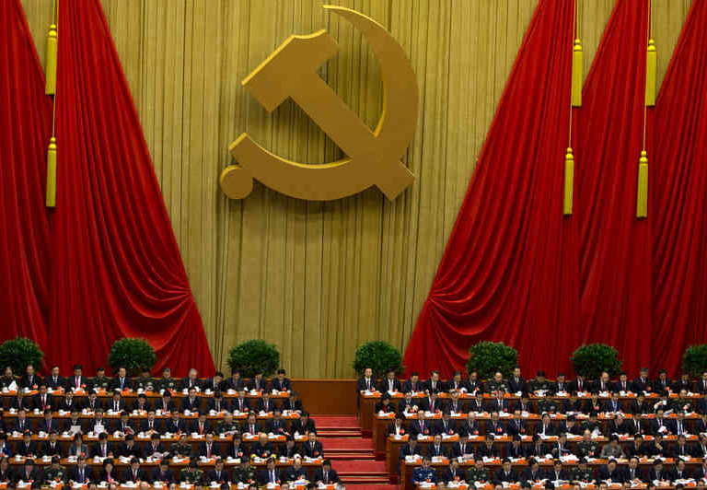
Who will Receive What is Produced?
Market v. Command

Slide 9
Key Characteristics of a Market (Free Enterprise, Capitalism) - Economy
Freedom of Enterprise
Right to enter a business of your choosing
Private Property
Right to own property and do what you wish with it
Profit Motive
Acquisition of wealth drives decisions made by businessmen

Slide 10
Key Characteristics of a Market (Free Enterprise, Capitalism) – Economy (cont.)
Consumer Sovereignty
What businesses produce is based on what consumers want and are willing to pay for
Competition
Many businesses in the same industry. Encourages innovation, lower prices
Freedom of choice
Consumers have more than one option when they purchase goods or services

Slide 12
Is the United States a Market Economy?

Slide 13
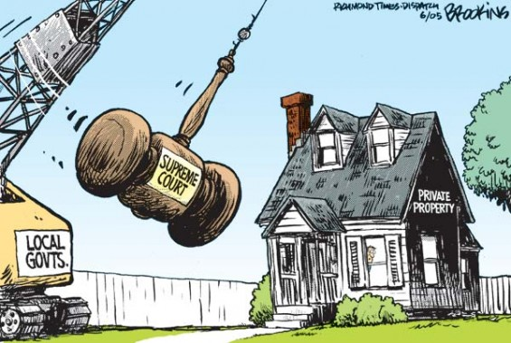

Slide 14
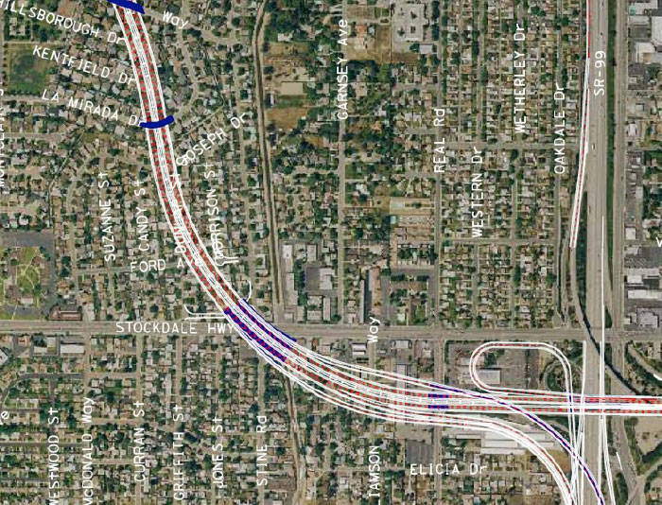

Slide 16
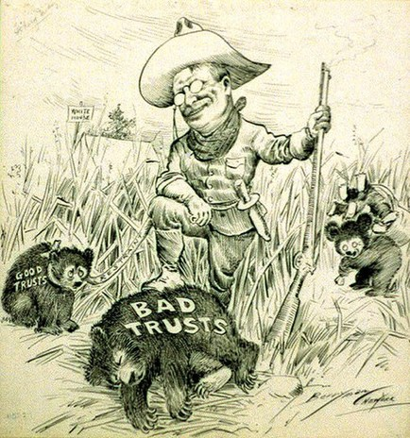

Slide 17
Is the United States a Market Economy?
Sort of - More accurately it is a Mixed Economy.

Slide 18
THE ECONOMIC SPECTRUM
United States in 1840
Market
Economy
Command
Economy
THE DREADED “S” WORD -
SOCIALISM
– private ownership of Land and businesses.
- Government owns major industries and provides certain key services (healthcare, education), and provides extensive “safety net)

Slide 19
The United States Free Enterprise System
Characteristics -
Freedom of Enterprise
Private Property
Profit Motive
Consumer Sovereignty
Competition

