Slide 1
Economic Decision Making
Opportunity Costs and The Production Possibilities Curve

Slide 2
Do Now
You have $300 dollars and must spend it by next week. You have three choices – I phone, Plane ticket to Florida to visit ill grandma, or taking yourself and three friends to a concert or ballgame. Give an advantage and disadvantage of each. What choice would you make? Why?

Slide 3
Opportunity Cost
What you give up when making a choice between two or more competing options

Slide 4
Opportunity Costs
How do families have to deal with opportunity costs?
School districts?
Government?

Slide 5
Eisenhower’s Warning
YouTube - Military Industrial Complex - Eisenhower 's warning
Military-Industrial Complex – collusion between the military, weapons manufacturers and congress to increase defense spending and adopt a foreign policy that would support that spending

Slide 6
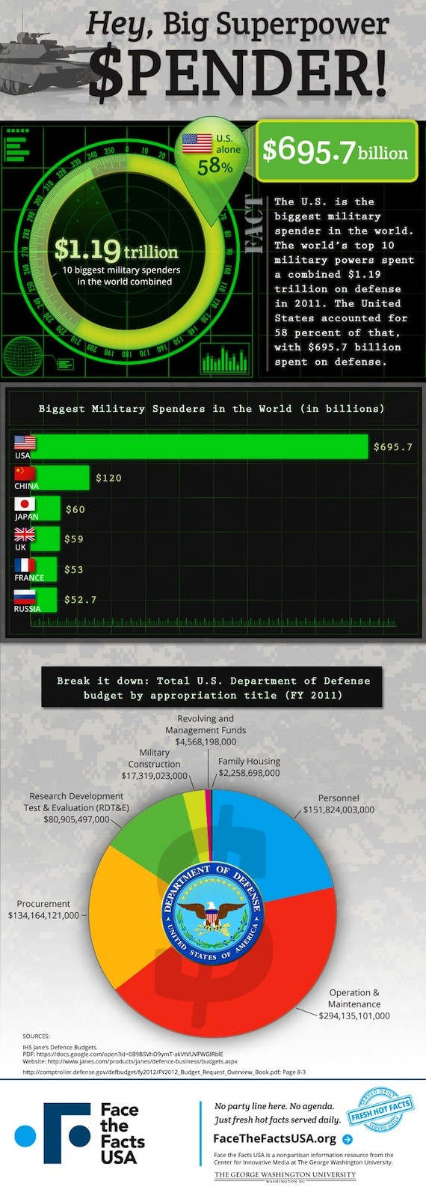

Slide 7
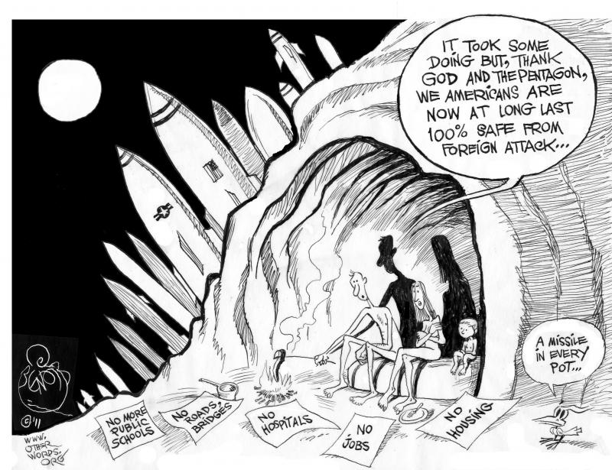

Slide 8
Production Possibilities Chart Farm Products v. Manufactured Goods
 | Farm Products | Manufactured Products | Opportunity Costs
1 | 15 | 0
2 | 14 | 5
3 | 11 | 15
4 | 5 | 25
5 | 0 | 30

Slide 10
Production Possibilities
Necessities | Luxuries | Opportunity Cost
600 | 0
550 | 40
500 | 55
400 | 80
300 | 90
150 | 100
0 | 110

Slide 11
I really want to do well on Monday’s test but there is that Justin Bieber Concert I want to go to and then there is that I-phone I wanted to get and I also feel as if I’m coming down with a cold or something. Oh dear what do I do?

Slide 12
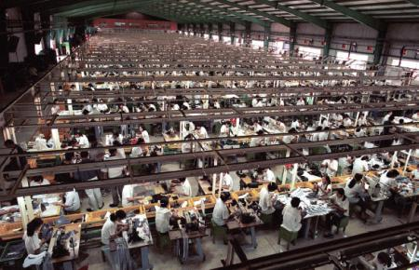

Slide 13
DO NOW
Explain two important decisions or choices you made over vacation.
Why did you make these decisions?
Did you give anything up by making the decision?

Slide 14
Economic Decision Making
Congratulations – you’ve just received $100! It’s burning a hole in your pocket, as you try to decide how to spend it. Identify four items that you can spend it on. Which of these would you buy? Why? How did you come to your decision?

Slide 15
Cost Benefit Analysis
- Evaluating a decision by applying the same set of criteria to different choices.

Slide 16
Possible Criteria
Brings benefits to greatest number of people
Durability – benefits are long lasting
Advances a goal of individual/organization making the decision
Does not require a future expense
Is it ethical?
Are there not potential negative unintended consequences

Slide 17
Externalities
Unintended consequences of a decision on a third party. Can be negative or positive.

Slide 18
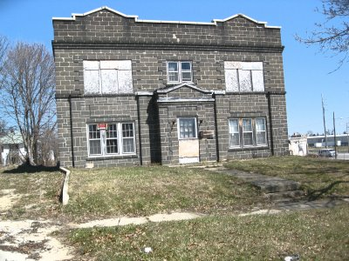
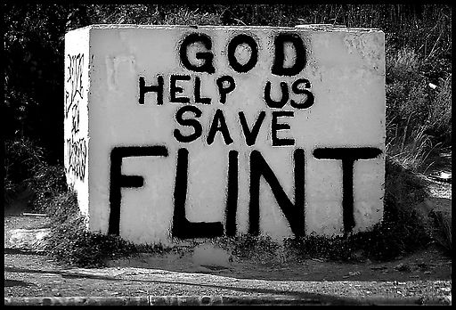
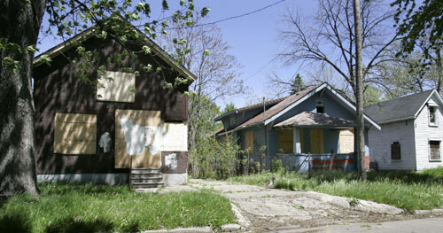

Slide 19
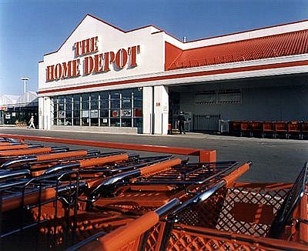

Slide 20
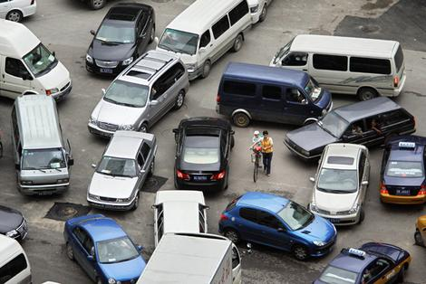

Slide 21
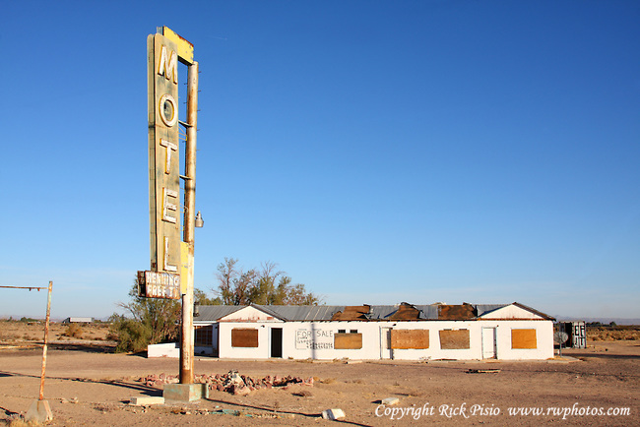
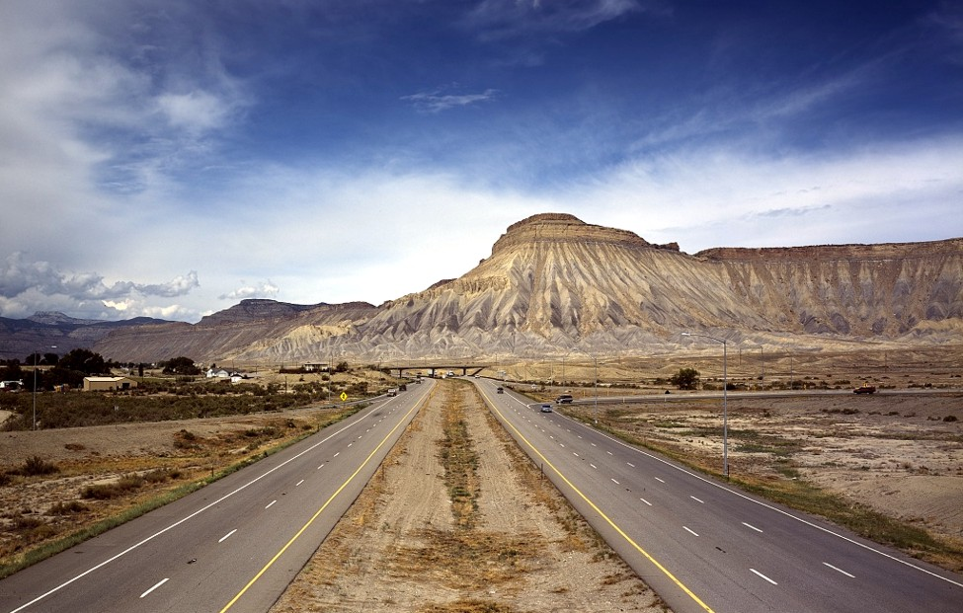
Abandoned Motel on
Route 66 in Arizona

Slide 22
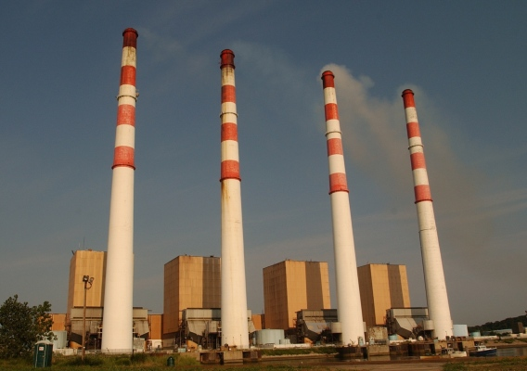

Slide 23
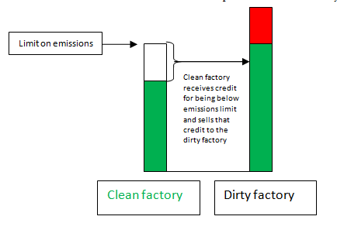
How cap and trade works

Slide 24
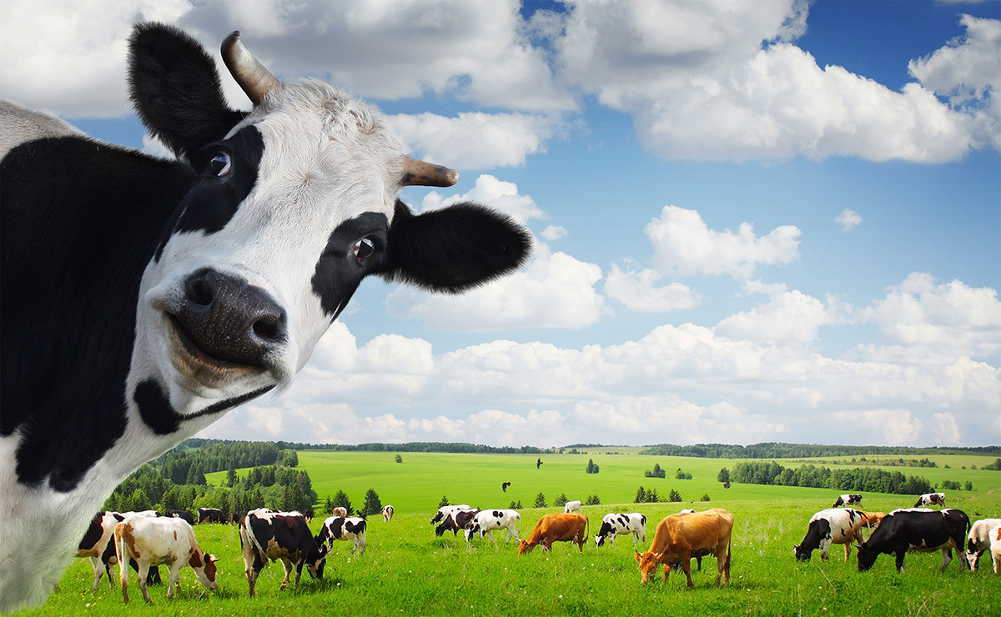
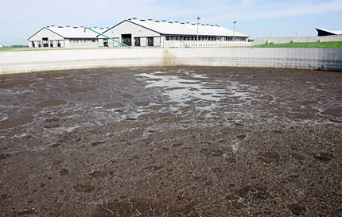
Carbon Markets
npr story january 2015 - methane and carbon markets

Slide 25
Carbon Markets and Cap and Trade
npr story january 2015 - methane and carbon markets
Holy . . . .
Cow!

